Slide 1

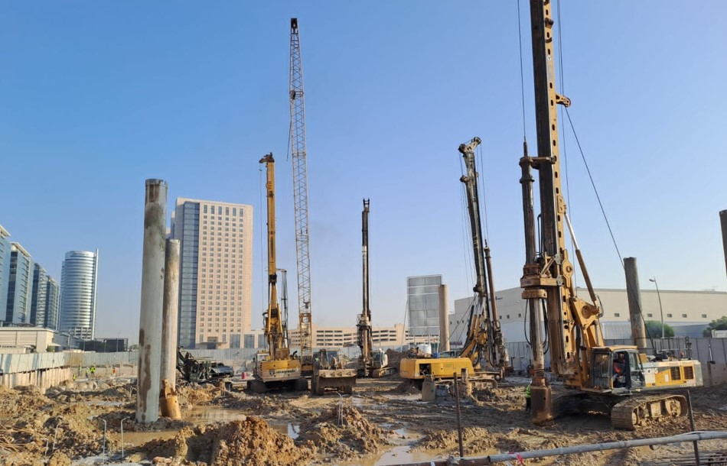
DXB | AUH | KSA | EGY

Slide 2
TABLE OF CONTENT
Megatech
Overview
01
About us, Areas of Specilization, HSE policies & Quality Assurance
Licenses &
Certificates
02
Trade Licenses and ISO Certificates
Practice
Permit
03
Practice Permits
Our Team
04
Organization chart and key personnel
Our Business History
05
Projects summary and top 20 Projects
Projects List
06
List of projects
Our Client’s Feedback
07
Accrediation and Appreciation Letters
Completion Certificates
08
DM, TRAKHEES, DDA
Our Equipment's
09
List of Equipments
Our Clients
10
List of Selected Clients

Slide 3
MEGATECH
OVERVIEW
BACK TO
MAIN

Slide 4
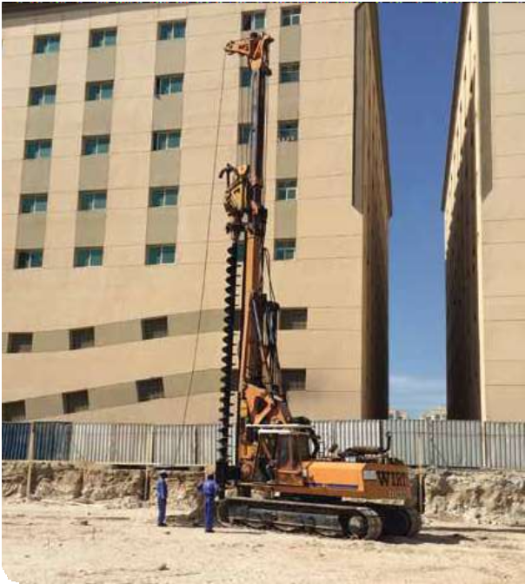
ABOUT MEGATECH
Mega Tech Foundation is a member of MEGATECH GROUP and is one of the best fully advanced and progressive companies in the United Arab Emirates, Egypt and Saudi Arabian. A 25 years of experience based on major projects established by extremely qualified and motivated team of engineers and support staff. It has built its reputation by introducing latest technologies, development, design, planning, scheduling and execution of projects.
Mega Tech undertakes diversified activities such as real estate, hospital, banks, sports and educational institutions, infrastructures, relevant ground working and industrial projects. We are seeking major achievements consequently engaging an unreachable rank in the Middle East.
Mega Tech has built its strength from its philosophy “Best Quality with Low Cost through efficient team” and sealed projects however large or small coequal excellency and prompt implementation.
Mega Tech keeps Environmental protection as its strategic priority, all its employees and contractors are well trained to maintain standards and procedures to ensure that they fully understand their environmental responsibilities.
Striving to minimize our environmental footprints wherever we work creating a healthy and harmless environment.
Mega Tech is committed to comply with all applicable legal requirements in order to provide safe, accident-free and healthy work environment.
The company’s health, safety and security is totally managed by Al Falah Security and Safety. Training sessions are conducted regularly to ensure that the employees are updated on the latest methods and techniques.
We believe that combining experience and technical knowledge enables us to strike our goals to a consistent progress. With this urge, Mega Tech is set out to inspire the piling industry and maintaining one’s perception “Best Quality with Lower Cost”.

Slide 5
AREAS OF SPECIALIZATION
The specialization covers the design and build of Foundation Engineering, All types of Retaining Structures, Marine Works, and Horizontal Directional Drilling (HDD).
(A) Foundation Engineering and Earth Retaining Structures:
Piled Foundations:
Large diameter rotary bored piles
Rotary piles using temporary casing
Continuous Flight Auger (CFA) piles
Plunge columns
Driven piles
Barrettes
Earth Retaining Structures:
Continuous piled walls
Secant piled walls
Post & plank walls
Diaphragm walls
Cased CFA piled walls using double rotary system Ground anchors
Ground Improvement
Vibro compaction
Vibro replacement
Stone columns
Grout plug

Slide 6
CONTINUED
(B) Marine Works:
Marine Foundation in its various forms such as:
Sheet piled walls
Driven pipe piles
Permanently cased rotary load bearings piles
Jetties
Quay walls
Dolphin structures
Ship lift basins
Marinas
Rock revetments
Pontoons and slipways
(C) Horizontal Directional Drilling:
Trenchless technology used in the installation of underground services such as:
Water lines
Oil lines
Gas lines
Pressure sewer lines
Telecommunication ducts
Electrical ducts
Shore approaches
Other environmental applications
(D) Dewatering Work
Will point system
Deep well system

Slide 7
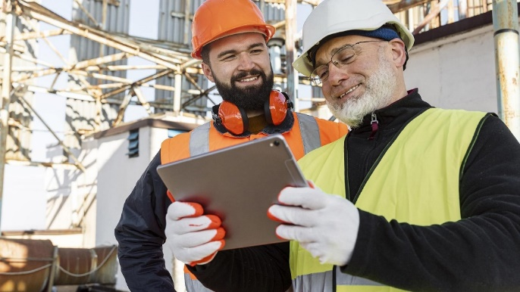
HSE POLICY
HEALTH, SAFETY AND ENVIRONMENT POLICY
Mega Tech is committed to a Clean, Safe and Healthy environment for its employees, contractors, customers and surrounding communities. Mega Tech committee, guided by the Safety Manager, who is responsible for the regular review of the companies Safety, Health and Environmental policies, and for the guidance of the company in its implementation, and for monitoring performance.
MEGA TECH WILL:
Adopt a Health, Safety and Environmental policy that meets the needs o f our business.
Hold line management accountable for the implementation of the Health, Safety and Environmental policy.
Develop and maintain appropriate procedures to support the Health, Safety and Environmental policies .
Manage Health, Safety and Environmental risks in a manner that meets the legal requirements of the U.A.E.
Be prepared for and deal with any emergency.
Ensure that employees and contractors are trained effectively.
Maintain a record of Health, Safety and Environmental information and to meet statutory record-keeping requirements.
Audit its performance against its policies, standards and procedures and to report this regularly to the executive committee.
MEGA TECH VISION:
With the cooperation of each individual, we will maintain a Healthy, Safe and Secure Working environment for all employees in which each employee, without discrimination, will be encourage to develop to his or her full potential.

Slide 8
QUALITY ASSURANCE POLICY
QUALITY ASSURANCE POLICY
Mega Tech quality assurance policy is based on principles and values provided for in the Company’s Mission, strategy and goals.
Quality Management System (QMS) creation is a major strategic direction of the business activities. The QMS is regarded as a useful tool for creation and management of effective business processes. The system formation will result in provision of services of consistently high quality, fully meeting customers’ expectations.
THE COMPANY PURSUES THE FOLLOWING GOALS IN THE FIELD OF QUALITY ASSURANCE:
Strict compliance of the company’s services with international, nation al, and corporate standards and requirements.
Professional and technical level of the services must correspond to or exceed that of the leading enterprises and companies operating in the U.A.E market.
Responsibility to customers for the quality of the services rendered.
Cost efficiency of the services as compared with other companies operating in the market.
Development and implementation of new services that fully satisfy our customers’ needs.
Continuous monitoring of complaints and claims from customers, and aim to maintain these at zero.
Positioning of the company as employing professional staff educated and trained to the required level, providing services of high quality.
THE STRATEGY FOR ACHIEVING THE GOALS IS THE FOLLOWING:
Focus on the process management model and continuous improvement of the company services (in accordance with the market requirements).
The QMS development, implementation, and maintenance in conformity with ISO 9001 international standards.
Satisfaction of customers’ requirements to all services. Fulfillment of the customers’ requirements within the shortest periods of time, ensuring highest quality. The services can be provided under Service Level Agreements (SLA).
Understanding of the customer needs, their present and future specific requirements.

Slide 9
CONTINUED
Continuous cooperation with customers in order to understand their needs.
Transparency - customers obtain access to information on the quality of the services.
Priority of quality issues in “personnel – technology - organization” chain.
Strict quality assurance procedures at all stages of the services life cycle, well-defined personnel responsibility for quality assurance.
Primary focus on prevention of a possible decrease in quality rather than on measures to restore the quality level.
(10) Consistent training of all personnel in the sphere of quality, each employee’s participation in services improvement, rewards for quality improvement.
ENVIRONMENTAL POLICY
Mega Tech is committed to acting in an environmentally responsible manner. To achieve this result, we:
Ensure our products, operations and services comply with relevant environmental legislation and regulations.
Maintain and continually improve our environmental management systems to conform to the ISO14001 Standard or more stringent requirements as dictated by specific markets or local regulations.
Operate in a manner that is committed to continuous improvement in
environmental sustainability through recycling, conservation of resources, prevention of pollution, product development, and promotion of environmental responsibility amongst our employees.
Responsibly manage the use of hazardous materials in our operations, products and services, and promote recycling or reuse of our products.
Inform suppliers, including contractors, of our environmental expectations and require them to adopt environmental management practices aligned with these expectations.

Slide 10
TRADE
LICENSES
&
ISO CERTIFICATES
BACK TO
MAIN

Slide 11
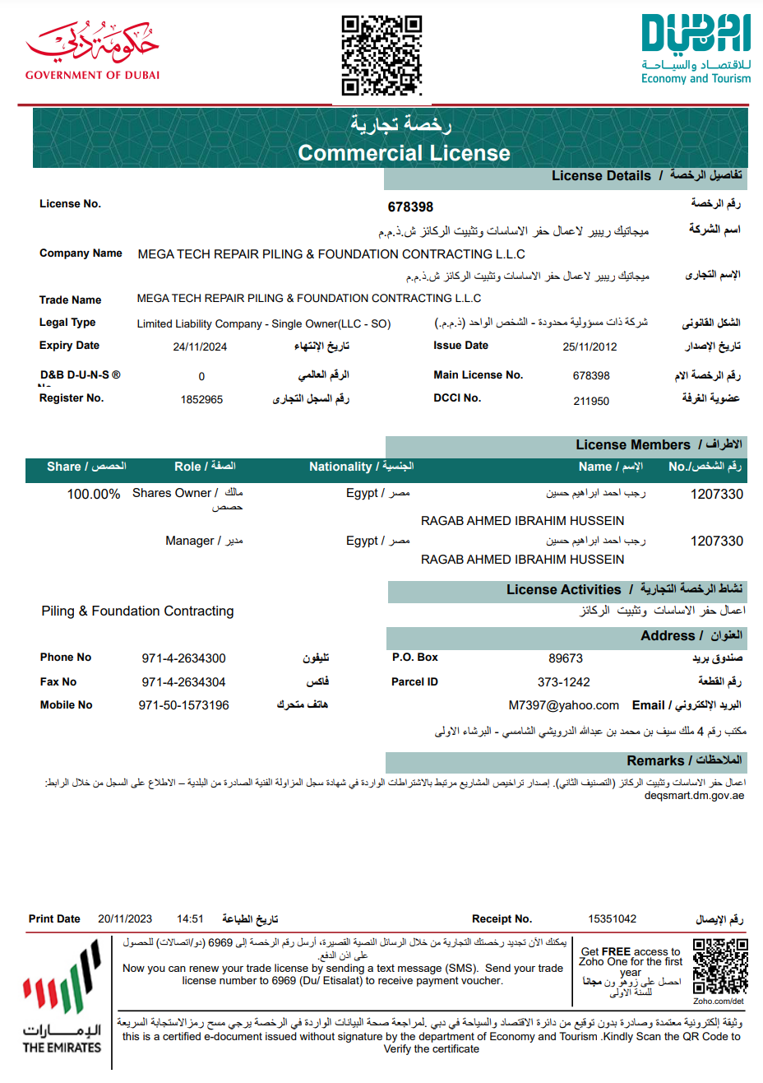

Slide 12
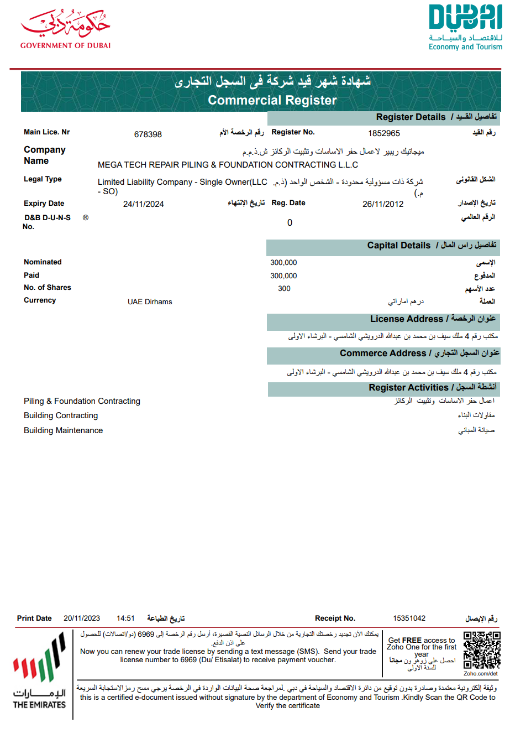

Slide 13
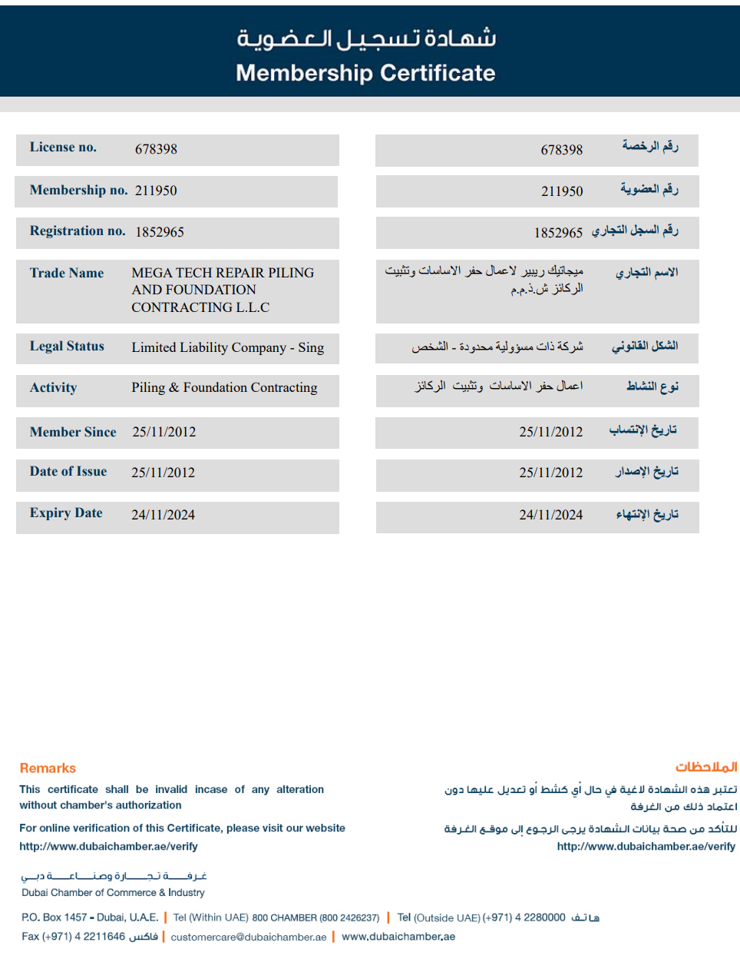

Slide 14
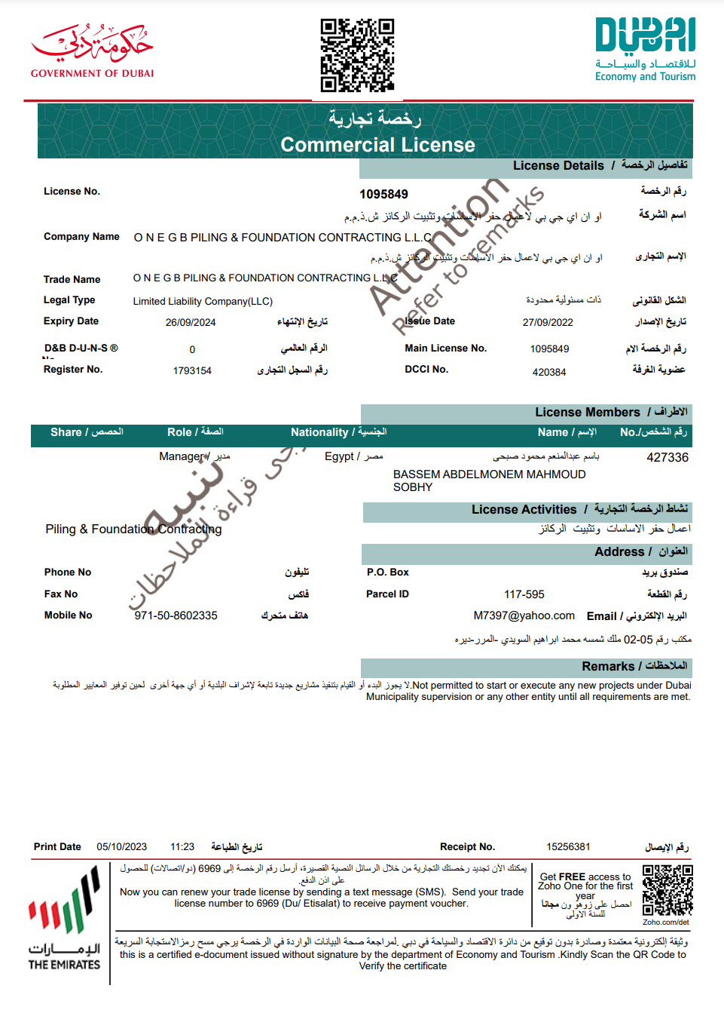

Slide 15
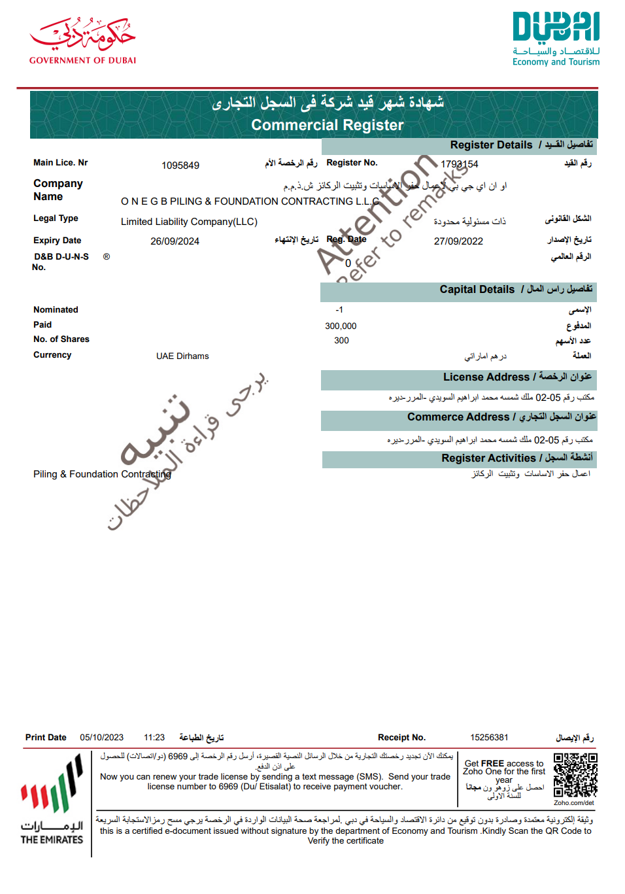

Slide 16
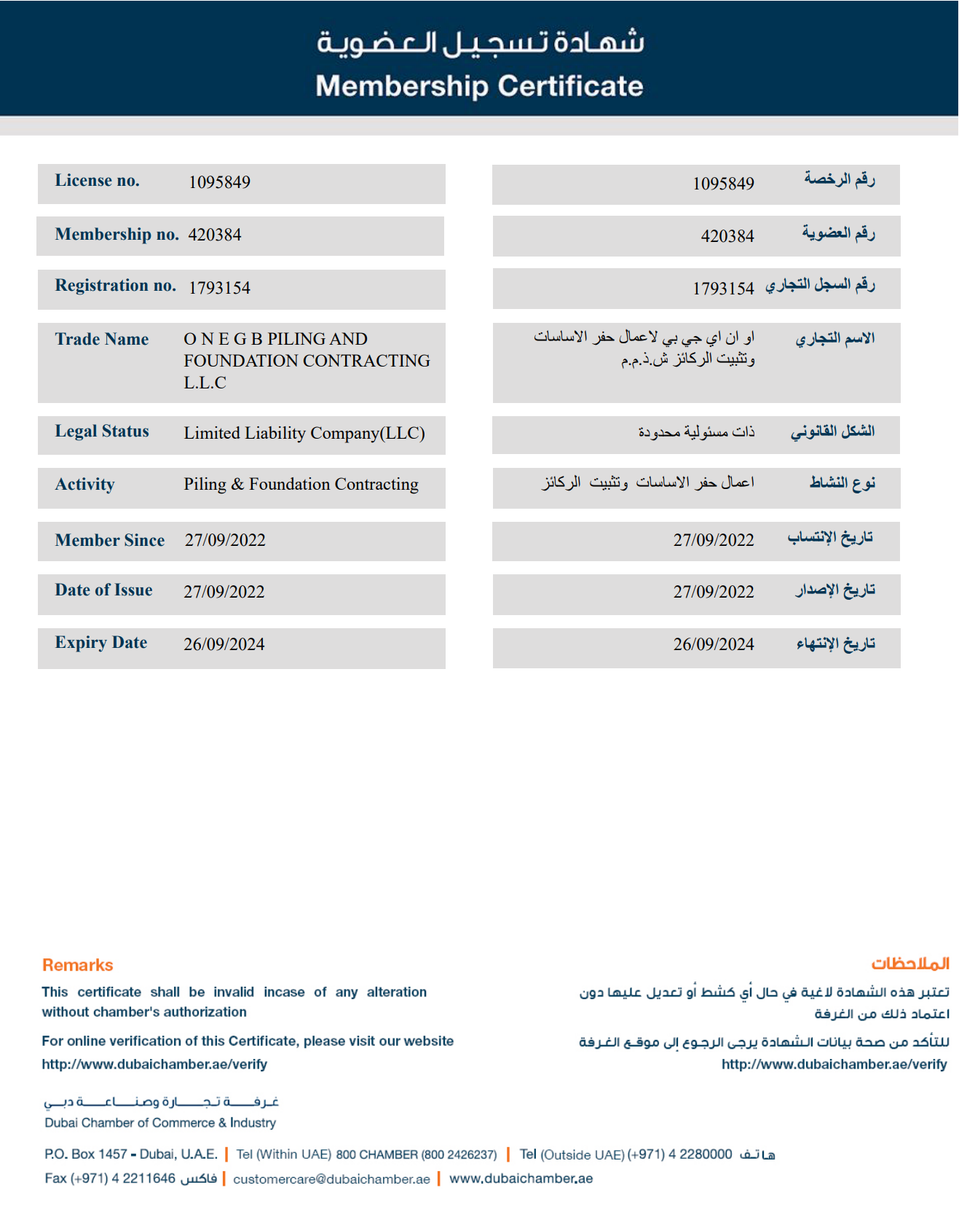

Slide 17
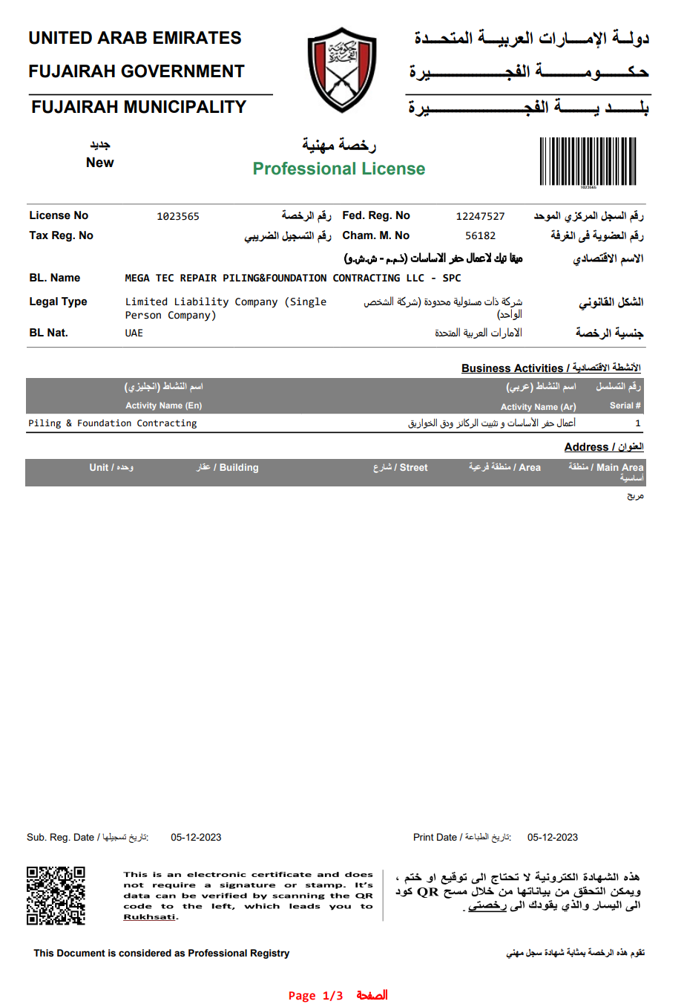

Slide 18
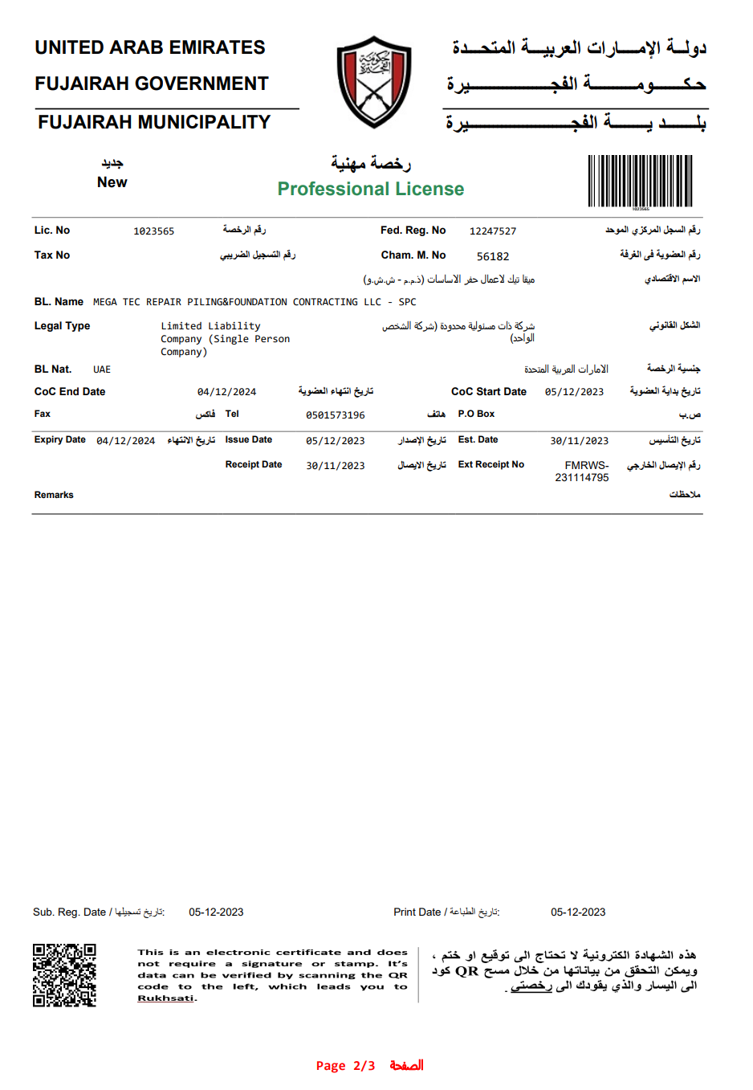

Slide 19
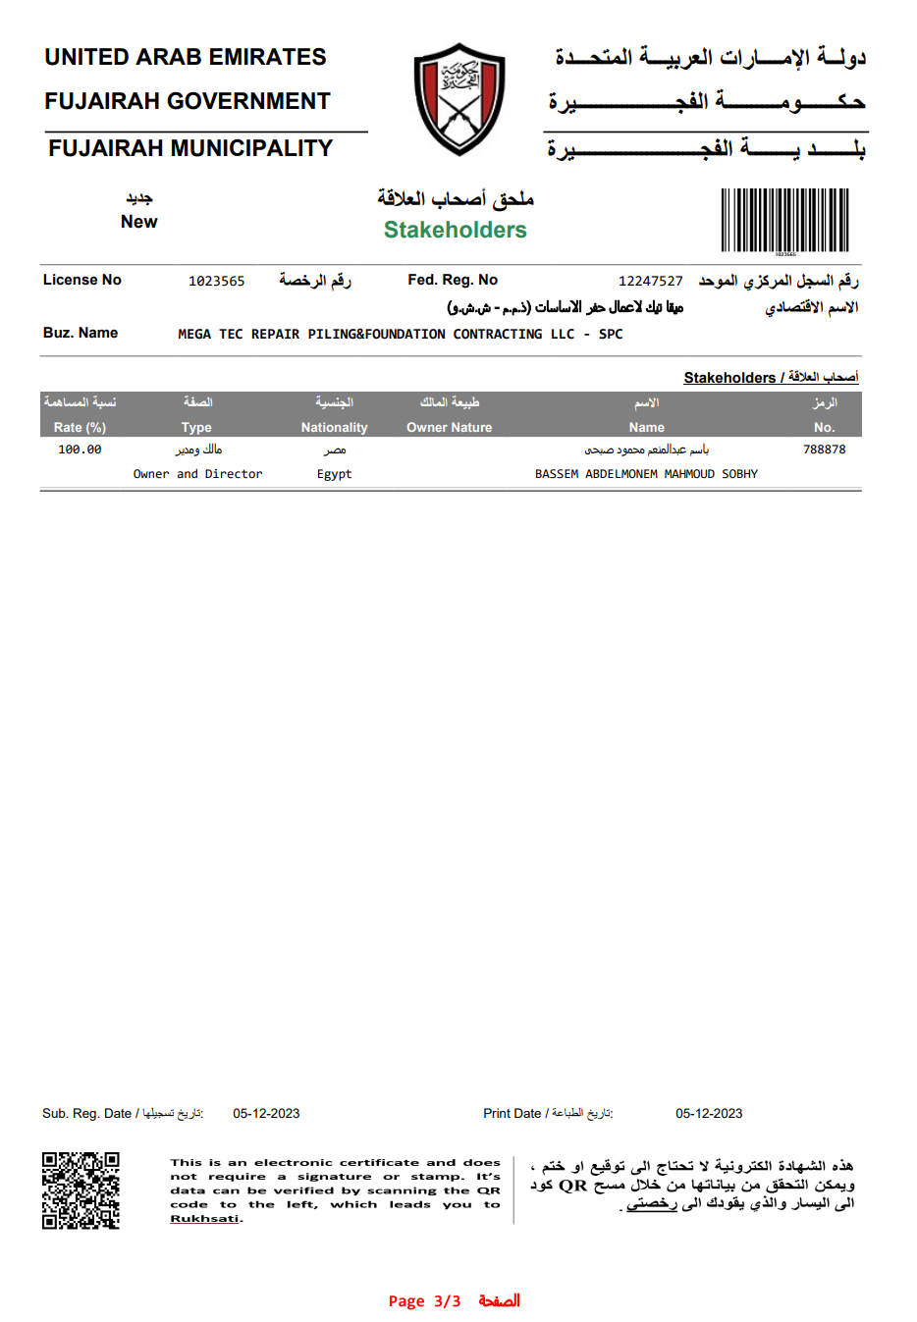

Slide 20
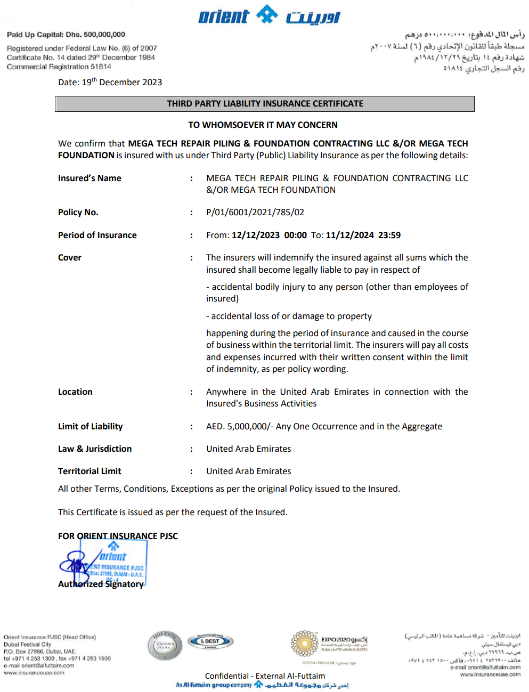

Slide 21
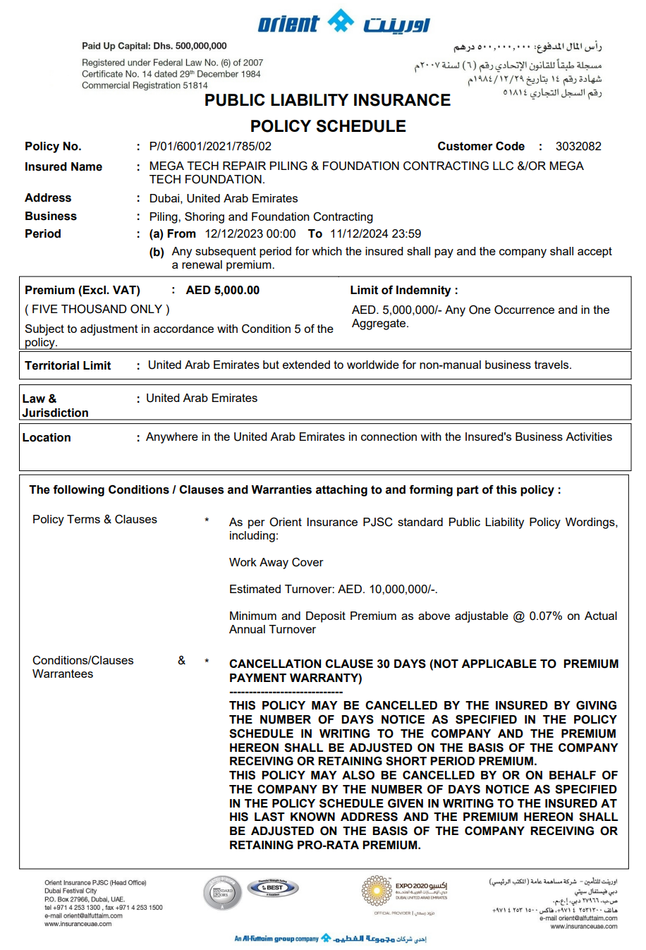

Slide 22
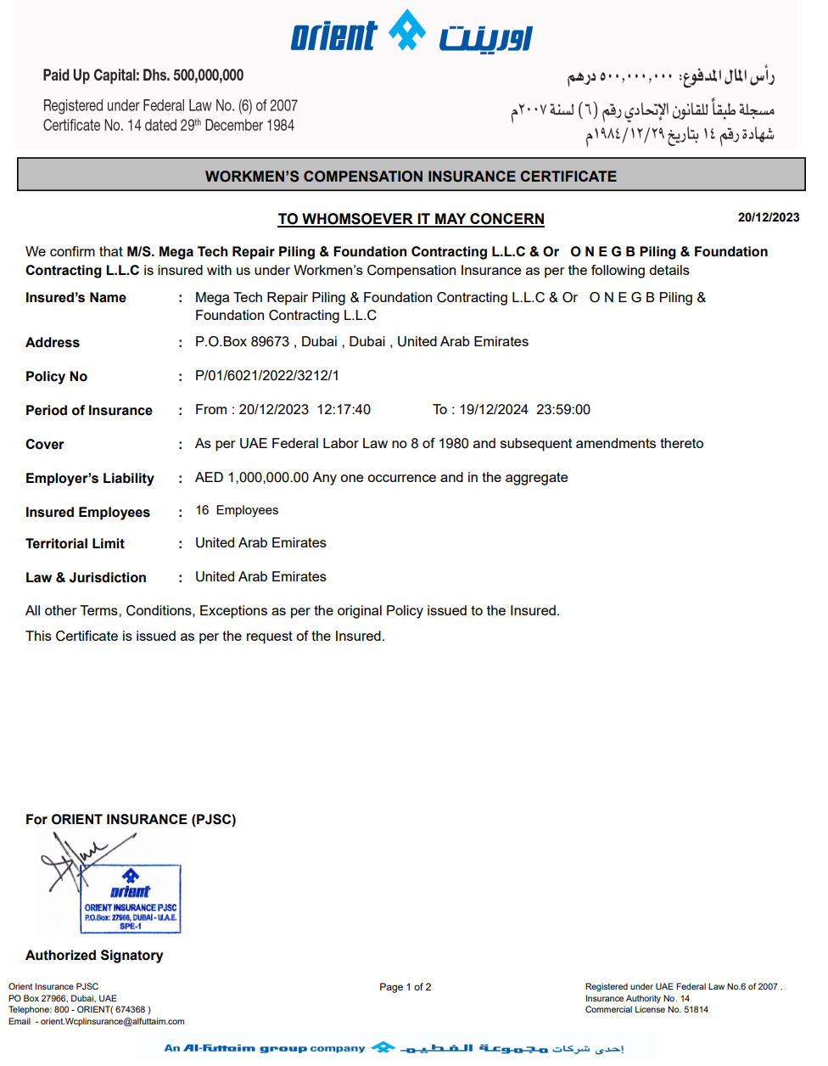

Slide 23
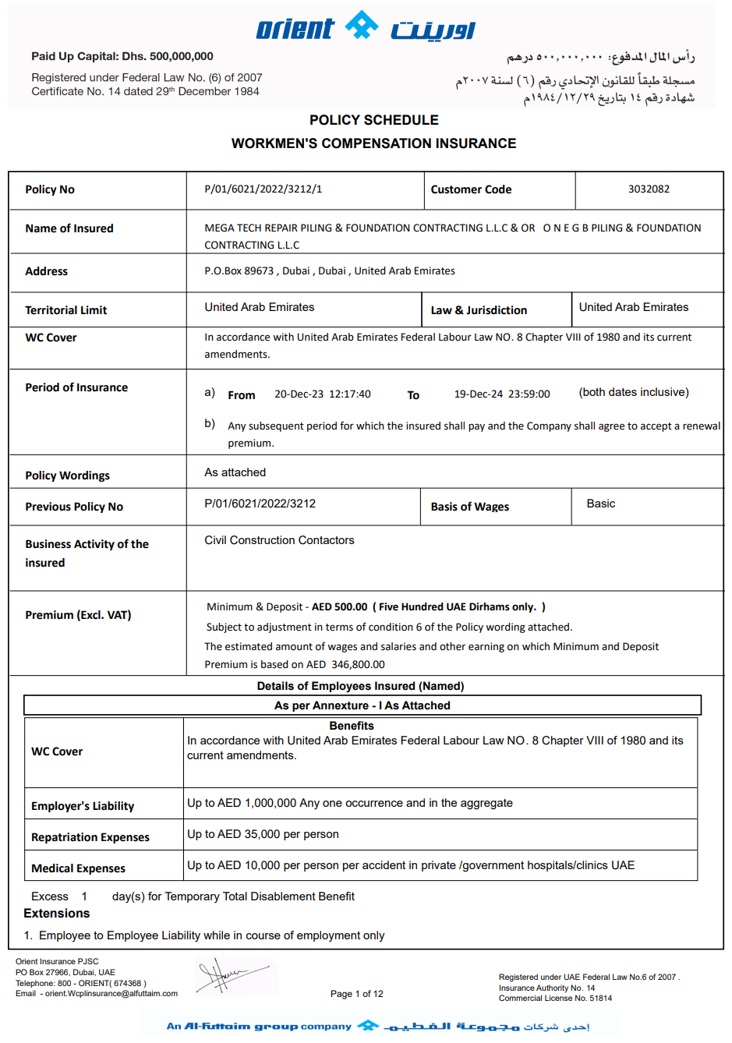

Slide 24
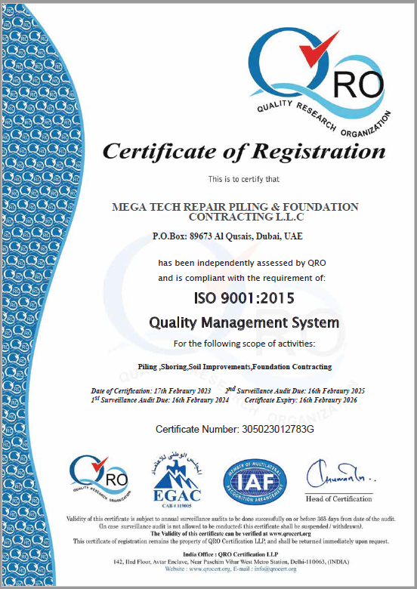

Slide 25
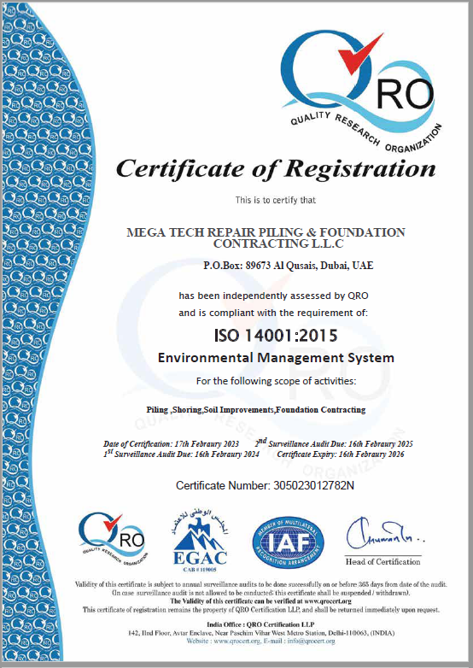

Slide 26
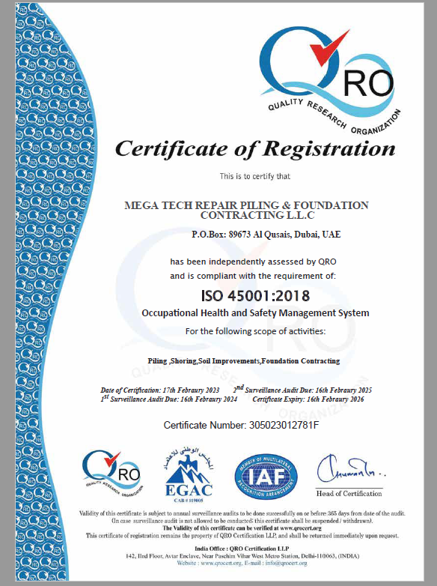

Slide 27
PRACTICE
PERMIT
BACK TO
MAIN

Slide 28
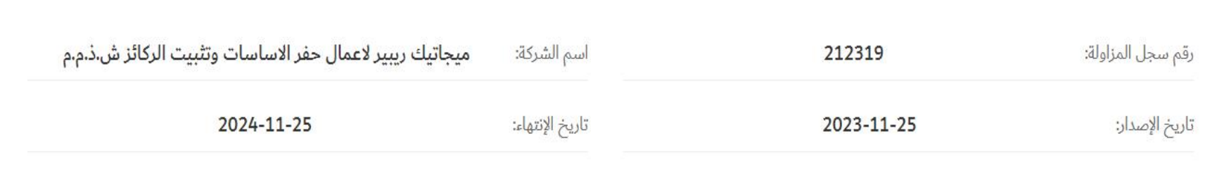

Slide 29
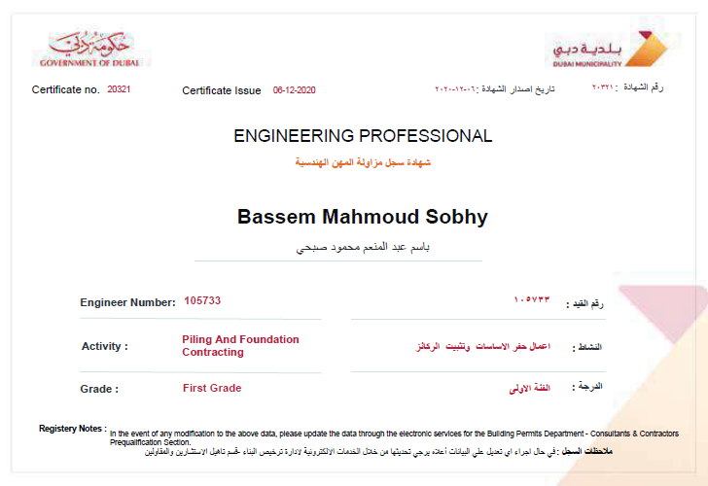

Slide 30
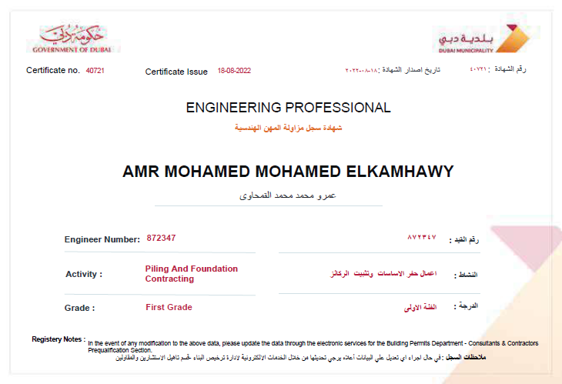

Slide 31
OUR
TEAM
BACK TO
MAIN

Slide 32

















ORGANIZATION CHART
CEO
Eng. Bassem Sobhy
CFO
Amjad Darwish
Accounting
Secretary
Projects Director
Eng. Mamdouh Hanna
Logistics
Administration
Technical Manager
Eng. Omar Bassem
Operation Manager
Eng. M. Shenawy
Design Engineer
Eng. Amro Al Kamhawi
Safety Engineer
Eng. MD Ahammed
Quality Control
Eng. Hussein Nawito
Mechanical Dept.
Eng. Hesham
Surveyor
Ahmed Fathy
Project Manager
Eng. Ahmad Shrief
General Forman
Shoring
Project Coordinator
General Forman
Piling
Rig Operator
Rig Operator
Rigger
Rigger
Crane Operator
Crane Operator
Vibrator Operator
Vibrator Operator
Welder
Welder
Helper
Helper
Flag Man
Pile
Tester
Flag Man

Slide 33
TECHNICAL CONSULTANT
HAMED BASSIOUNY
Designation: Technical Consultant
Education: Ain-Shams University, Cairo 1976
B.SC in Civil engineering, structure department. Consultant Engineer from the Egyptian Engineering
Syndicate in the Field of supervising of civil construction Projects
-
Engineering Profile:
Performance and detail – driven Senior engineer with over 35 years’ experience of progressively responsible supervisory, business development, complex project management, and technical design positions. Efficient, organized leader with success in coordinating efforts within internal-external teams to reach and surpass expectations. Broad based responsibilities in structural design engineering, procurement and construction. Comprehensive knowledge of design standards and codes. Strong leadership skills to motivate colleagues, persuade clients, and forge strong alliances, and demonstrated ability to build long-term client relationships and determine cost effective solutions to design, process, or regulatory issues. Proven ability for proactive trouble shooting and ensuring smooth operations and optimal functionality
Core Competencies/Key Strength:
Team Engineering Management
Vendor Qualification
Supervisory and Testing
Procedures and Specifications
Equipment Design, Selection Troubleshooting and Problem Resolution
Cost Reduction Strategies
Pre-commissioning, Commissioning of tenders and Start-up of Projects
Checking all types of projects submitted for building permits including – high rise buildings, industrial building and commercial buildings steel and concrete.
Checking Post tension Slab Design
The Scope of work also includes discussing new structure systems submitted for Municipality approvals.
Interview contractors and consultants’ staff for registration ro renewal of their license in the Municipality.
Investigating and solving site problems accidents with the supervision section.
Participating in different committees for updating the codes used and improving the work system.
Identify information gaps and work with contractors and consultants to collect relevant information.
Facilitated smooth execution of projects by attending regular progress meetings with Clients and visiting construction sites. Conceptualized, identified, and resolved field problems quickly and diplomatically thus saving time and money for both parties

Slide 34
PROJECTS DIRECTOR
Mamdouh Tawfic Hanna
Designation: Projects Director
Education: Bachelor of Science: Cairo University 1980 Civil Engineering
Diploma in Soil Mechanic Cairo University 1982
Training Courses: Project Management
Training for Deep Foundation Basic H2S
Qualifications: Over 40 years of Experience in the construction Industry of commercial, Public Industrial, Residential (High & Low rise) Towers, Villas, Hospitals.
Employment History:
July 2016 – Present:
Mega Tech Repair Piling & Foundation Contracting L.L.C
General Manager:
Responsible for all activities of deep foundation, Pile Testing, Shoring and Soil Improvements Work.
Sept. 2013-July 2016
Al Neel Foundation – Dubai, U.A.E
General Manager:
Control the unlimited company with projects over 800 Million/year
Sept. 2005 – Oct.2016
Piling Tech-Dubai, UAE
Executive Manager:
Plan, coordinate, supervise and oversee all daily site operations, Monitor the project using various reports, Hold meetings with the Consultant, Employer to ensure that the Construction team meet all the required Progress, Quality to proceed with the work stages.Also involve the end users, operators, facility management, etc in the earlystages of the Progress to minimize changes in the later stages.
Jan 1998 – Aug. 2005
National Engineering Bureau Consultant (N.E.B), Dubai, U.A.E
Project Manager:
Take the project from concept stage to completion, identify suitable partners to implement the development activities, ensure delivery and quality of the project, Plan, coordinate, supervise and oversee all daily site operations, Monitorthe project using various reports, award of contracts,

Slide 35
PROJECTS DIRECTOR
May 1993 –Dec. 1998
Ahmad Bin Dasmal Cont. Co. Dubai, U.A.E
Project Manager:
Preparing and overseeing capital projects. Obtaining tender documents, price negations with subcontractors. Coordinates and works in conjunction with consulting engineers during the construction phase of major projects. Evaluate development of project scope and budget, monitoring targets and program ofwork.
June 1986 – April 1993
Sector Engineer- Al-Selex Contracting Co. – Abu Dhabi, U.A.E
Project Engineer:
Monitoring project progresses, prepare shop drawings, prepare material submittals, perform all type of site inspections, prepare monthly Payment, Co-ordination of all services with main program and hold site meetings.

Slide 36
DESIGN ENGINEER
Amro Al Kamhawi
Designation: Design Engineer
Education: Bachelor of Science: Arab Academy for Science and Technology Civil Engineering – 2014
Training Courses: Certified from Dubai Municipality (Unlimited floor Contracting)+(Piling and foundation Contracting First Grade), Fresh Concrete Testing in the Field (orange card from TRAKHEES)
Employment History:
Feb 2017 – Present:
Mega Tech Repair Piling & Foundation Contracting L.L.C
Designer:
Liaise with authorities (Dubai, Sharjah & Abu Dhabi Municipality RTA, DDA Etc. toObtain Approvals & NOCs.
Design Piles, Micro piles, and Slope stability work.
Supervising the implementation of the project from the Main contractor China state(piles, Micro piles, install beams works).
Apply all RTA NOCs Including but not limited to: Information NOC, Preliminary/ Final Design NOC, Trial Trenches NOC, Shoring NOC & Construction NOC.
Working to get completion certificates for the same.
Designer for Shoring work, piles work& Soil improvements by Reward, Wallap, Allpiles, Plaxis, GeoStudio programs Analysis, Plaxis 2D&3D & Stone C (piles, Micro Piles, Steel Beam, Sheet Pile, Secant pile, contiguous pile, strut work, Anchors work &Stone Columns Etc.
Receiving inquiries and preparing quotations.
Planning for projects using primavera p6
Quantitative works for both concrete and steel.
Structural shop drawings for shoring and piling work.

Slide 37
DESIGN ENGINEER
Ensure that the project is coordinated and delivered on time and within the budget, as per the tender documents.
Cost estimate for shoring work to provide an actual price.
Knowledge to use Dubai Municipality System & TRAKHEES & DDA and Sharjah Municipality ( Submit new projects – demarcation – inspection – sand shifting permit –follow up for projects).
Follow up with sites and arrange to provide the requirements of the site to serve the cost control plan.
Resolving any unexpected technical difficulties and other problems that may arise at the site.
Dec 2015 – May 2016
El Gendy Pilling & Foundation
Site Engineer:
Structural shop drawings for piling work.
Ensure that the project is coordinated and delivered on time and in budget, as per thetender documents.
Responsible to guide foreman and skilled workers to complete the work as per theschedule program and quality
Quantitative works for both concrete and Steel.
Execution of piles and soil Improvement work
Site management, labor, and planning activities

Slide 38
OPERATION
MANAGER
Mohammad Al Shenawi
Designation: Operation Manager
Education: Bachelor Degree Civil Engineer
Delta University – Al Mansoora – Egypt- 2014
Employment History
March 2020 – Present:
Mega Tech Repair Piling & Foundation Contracting L.L.C
Operation Manager:
Supporting the project management to satisfy the client requirement.
Monitoring relevant safety objectives and legal requirements to maintain A safe and clean working environment.
Coordinate with Project Manager to manage & finish the critical activities In order by addressing the priorities firstly.
Attend all consultant inspections & undertake all necessary follow-ups.
Review Daily, Weekly, and Monthly Reports.
May 2017 – Feb 2020
Mega Tech Repair Piling & Foundation Contracting L.L.C
Project Engineer:
Inspect materials delivered and report on quantity and technical Compliance.
Resolve any unexpected technical difficulties and other problems.
Ensure that the job is completed within the budgeted time & Cost.
Ensuring the compliance to the company safety rules and regulations are Strictly observed through proper supervision.
Feb 2015 – March 2017
Al Amar Building Contracting – Cairo – Egypt Site Engineer:
Managed manpower and machinery
Performed field inspection and to review field modifications & prepared as built drawings to meet the company requirements.
Reviewed the instrumentation construction drawings to make sure they Meet the company and standard specification.
Review of drawings, specifications and provide technical clearance to site Engineers / site foremen.

Slide 39
TECHNICAL
MANAGER
Omar Bassem Sobhy
Designation: Technical Manager
Education: Bachelor of Science Civil Engineering
Sharjah University – Sharjah – U.A.E 2021
Employment History
March 2020 – Present:
Mega Tech Repair Piling & Foundation Contracting L.L.C
Technical Manager:
Prepare a complete design package including performing calculations and preparing plans and drafting for temporary works
Coordinate design effort with the project manager to deliver designs within budget, time and quality constraints
Prepare written reports and submittals for temporary and permanent works designs including calculations and drawings

Slide 40
PROJECT
MANAGER
Ahmad Shareef
Designation: Project Manager
Education: Bachelor Degree Civil Engineer
Future University – Egypt- 2018
Employment History
March 2019 – Present:
Mega Tech Repair Piling & Foundation Contracting L.L.C
Project Manager:
Supervise All Shoring, Piling, Soil Improvement works Reporting to the Section Head of the work team & giving all the Information required for the works.
Jan 2018 – Feb 2019
Al Neel Foundation – Cairo – Egypt
Site Engineer:
Inspect materials delivered and report on quantity and technical Compliance.
Resolve any unexpected technical difficulties and other problems.
Ensure that the job is completed within the budgeted time & Cost.
Ensuring the compliance to the company safety rules and regulations are Strictly observed through proper supervision.
Checking plans, drawings & quantities for accuracy of calculations.
Managed manpower, machinery, & other required resources ensured Quality control, Organizing materials and ensuring sites are safe & clean.
Supervisor, monitoring and coordination of subcontractors.
Preparing cost estimates and ensuring appropriate materials and tools Are available

Slide 41
OUR
BUSINESS HISTORY
BACK TO
MAIN

Slide 42
2023
Projects
Value
: 41
: 10.040 M
Projects
Value
: 16
: 6.106 M
2022
2021
Projects
Value
: 16
: 4.303 M
Projects
Value
: 16
: 3.222 M
2020
2019
Projects
Value
: 44
: 11.336 M
Projects
Value
: 50
: 18.216 M
2018
2017
Projects
Value
: 22
: 20.849 M
Projects
Value
: 10
: 16.462 M
2016
2015
Projects
Value
: 11
: 9.218 M
Projects
Value
: 9
: 7.500 M
2014

Slide 43
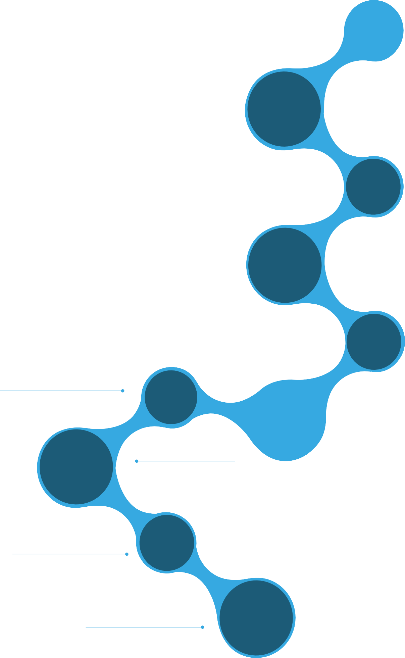

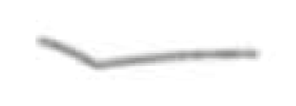


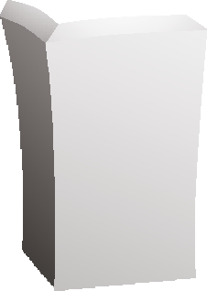


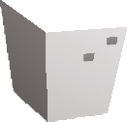










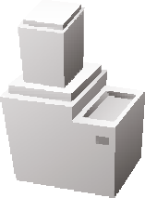










TOP 20 PROJECTS
Soil Improvement - Stone Columns work-Santorini - Phase 2 -RAK
01
Dubai Civil Engineering
Executing 650 stone Columns pile with 600mm dia with depth 10m 10000 m2 Vibro compaction
02
AG POWER Contracting
BYOTAWIR 132/11KV DEWA SUBSTATION - DXB
274 piles with 600mm dia with depth 17M
90LM Shoring work by steal beam
G + 4P + 19 TYP + R Jabal Ali - DXB
03
PROGRESS
Construction
242 piles with 1000mm / 900mm dia with 27m depth
322LM Shoring work by steal beam
1410 stone column
04
GGICO
3B + G + 6 Floors
Al Barsha - DXB
Secant Pile, Shoring system, Micro-piling System, Excavation Works
Street Light Foundation-Swihan - AUH
05
China State
Construction
Executing 400 pile, 600mm dia
B+G+M+3Typ. Floors + HC + R, Comm./Resd. Bldg. - DXB
06
253 pile with 1000mm dia with 16m depth
General Construction Company
Bab Al Qasr Hotel & Serviced Apartments - AUH
07
Nurol L.L.C
245 piles using bored pile 1000mm dia depth 33m piles 1200mm dia depth 31m using Bentonite system
08
DHABI Contracting
Al Khail Avenue Mall including 15 Floor Hotel - DXB
Shoring Works 1200 L.M
09
Al Fanar Contracting
4 nos Substation 132/11KV - DXB
Hessat Street, Um Ramool, Marasi, Tower Kifaf
Executing Piling and Shoring Works for DEWA
10
Triply Construction.
3 Basement Shoring work Commercial building - AUH
320 Piles, 800mm dia depth 24m, 285 L.M Shoring Works

Slide 44
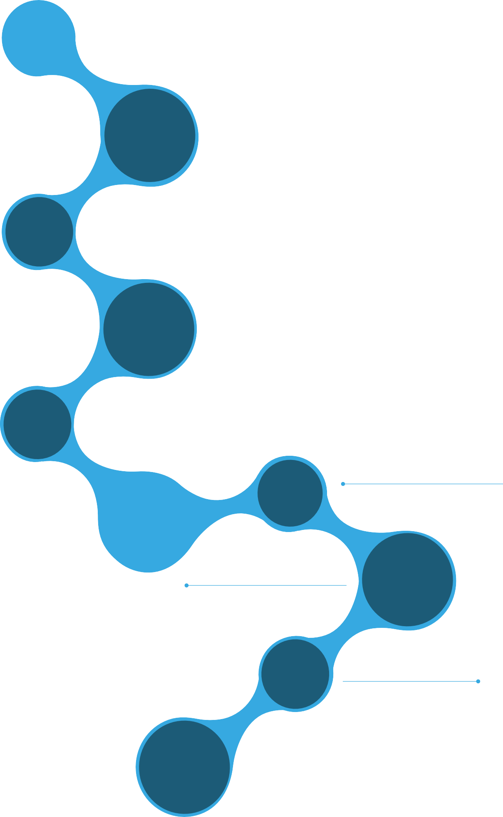




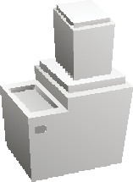




















11
Granada Europe
Bin Ghatti Avenue Commercial & Residential Building B+G+MZ+4P+27 - DXB
Piling Work 418 Piles with dia 1000mm, 900mm, 800mm, depth 22M
Hotel Building G+13 - DXB
12
MESC
Soil Improvement by Stone Column
13
JSCOM Contracting
Commercial & Residential Building B+G+3P+16 -DXB
Piling work 321 piles with dia 1000mm, 24m depth
G+Mezz., Factory and offices plot No. 5970580 at DIP Second , DXB
14
Dubai Civil Engineering
Executing 358 stone Columns pile with 600mm Dia and Shoring work .
15
Modern Building Contracting
Arabian Tower 3B+G+3P+25 TYP+R- DXB
Piling work 239 piles with dia 800mm, 22m depth
17
City Greek
13 nos Commercial Building - DXB
Residential Building G+5P+33 - Al Qasba , SHJ
16
Al Qabdah Building Contracting Co
Shoring 473 L.M, Stone Column 4,055M2, Piling 101 x 600mm with 18m depth
Shoring Works 720 L.M
18
Al Nasr
Contracting
NETWORK FOR AKOYA PROJECT, DXB
Shoring Works by steel beams Hessa st. 2.6KM (2,600m) sheet pile max depth 15m
19
Commercial & Residential Building (B+G+4) - DXB
VICC VENCO IMTIAZ
Shoring works by steel beams 350 L.M
20
Al Khawajah Engineering
Commercial & Residential Building G+4P+14 - DXB
Piling work 236 piles with dia 800mm/ 1000mm with 29m depth

Slide 45
PROJECTS
LIST
BACK TO
MAIN

Slide 46
2023 Projects
# | Project Details | Work Description | Client
1 | Mixed Used Bldg. Plot No. JVC16NMRH300 - JVC | 480 Piles, Dia 600mm, 800mm, 1000 X 25mtrs | Tiger International Gen.Cont.
2 | Comm & Res Building (G+3P+14) Plot No. 326-5627 – Al Jaddaf | 140 Piles, Dia 800mm, 1000mm X 23mtrs | Tiger International Gen.Cont
3 | Mixed Used Bldg. Plot No. JVC16NMRH300 - JVC | 153 L.M Shoring by Steel Beams | Tiger International Gen.Cont
4 | Comm & Res Building (G+3P+14) Plot No. 326-5627 – Al Jaddaf | 83 L.M Shoring by Steel Beams | Tiger International Gen.Cont
5 | Proposed 2 Story Villa (B+G+1+R) Plot No. 343-5429 – Al Wasl | 100 L.M Shoring by Steel Beams, 10 L.M Secant Pile | Al Sham Building Conttacting
6 | Proposed 2 Story Villa (B+G+1+R) Plot No. 343-5478 – Al Wasl | 87 L.M Shoring by Steel Beams, 23 L.M Secant Pile | Al Sham Building Conttacting
7 | BHRTWRSN 132/11KVA Substation Plot No. IC2-01-17 INT.CITY | 30 L.M Shoring by Steel Beams | AG Power - DEWA
8 | Villa (G+2) Plot No. 1180 Al Luluyh Khorfakan - Sharjah | Soil Improvement by Stone Columns | Al Manar Building Contracting
9 | Villa (G+1+R) Plot No. 631-4200 Dubai Hills | 165 L.M Shoring by Steel Beams | DGM Contracting
10 | DW Drilling Well – Business Bay | 600mm – 900mm x 33mtrs | DWEX Technical Services
11 | Villa (G+1) Plot No. 927 Al Luluyh Khorfakan - Sharjah | Soil Improvement by Stone Columns | Zawaya Al Mamar
12 | Residential Building (B+G+5) Plot No. IC3-F52 – Int. City | 196 L.M Shoring by Steel Beams | Emirates Pearl Construction
13 | Proposed Villa (B+G+1), Plot No. 631-4273 - Hadaeq Sheikh Mohammed bin Rashid – Dubai | 110 L.M Shoring by Steel Beams | Emessa Building Contracting
14 | Proposed Villa (B+G+1+R), Plot No. 631-3386 – Dubai Hills – Dubai | 58 L.M Shoring by Secant Piles for Max Exc. 4.5M | DPI Interior Design & Decoration
15 | 2P+G+11+2R, Residential Building Plot No. 326-9878 – Al Jadaf – Dubai | Stone Column, Anchor Work, Install Temporary Shoring Works by Sheet Piles, Shoring Works by I Beam | SRH Albnyan Building Contracting
16 | Poposed Villa (B+G+1+R)+Swimming Pool, plot no. 3323791 Jumeira First, Dubai | 83 L.M Secant Piles | Modern Home Contracting

Slide 47
2023 Projects
# | Project Details | Work Description | Client
17 | Proposed Villa (B+G+1+R), Plot No. 631-6573 – Dubai Hills – Dubai –U.A.E | 45 L.M Shoring by Secant Pile,36 L.M Shoring by Steel Beams | DPI Interior Design & Decoration L.L.C
18 | IR 166 - Landscape & Irrigation system for Interchange of Al Khail Road With Mohd Bin Zayed Road | 64 L.M by Seacnt Pile, 97 L.M by Sheet Pile | Green Scapes Landscape & Maintenance Contracting
19 | Proposed Villa (1B+GR+1+R), Plot No. 631-2340 – Dubai Hills – Dubai –U.A.E | 52 L.M Permanent Shoring by steel beams, 103 L.M Secant Piles | DPI Interior Design & Decoration L.L.C
20 | Proposed Villa (B+G+1+R) +Swimming Pool Location: plot no. 347-0827 Al Merkadh, Dubai – U.A.E | 48 L.M Temporary Shoring by Steel Beams | Modern Home Contracting
21 | Existing Building – plot no. 9(129) Maysaloon Sharjah - U.A.E | Soil Improvement by Tam Grout, depth -08.0m from ground level, per point | Al Shahab Building Contractin
22 | MOUSQE - 51560, RAK - U.A.E | Soil Improvement by Stone Columns | Al Omran Al Momayaz Contracting
23 | Proposed B+G+1 VILLA Location: plot no. 332-2964 Pearl jumeirah, Dubai – U.A.E | 25 L.M Secant Piles, 52 L.M Temporary Shoring by Steel Beams | NAF Contracting
24 | Proposed (B+G+1+ROOF) Villa Plot No. 3260878 AT AL Khawaneej, Dubai | 57 L.M Shoring by Steel Beams | Albanna Conwood Construction L.L.C
25 | Gazebo Main Structure-Sir Baniyas Island - Abu Dhabi 647/R1/23-MRI/AE | Shoring by Secant Piles | Middle EastBridges & Tunnels Maintenance
26 | Etihad Rail, Stage 2Package 2B -Noise Barrier - UAE | Shoring by Secant Piles | MRI Middle East Bridges & Tunnels Maintenance
27 | KHOYOOL DEWA 132/11KV Substation Location: Meydan – Dubai – U.A.E | 16.6 L.M shoring by Secant Piles, 19 L.M Shoring by Steel Beams | AG Power - DEWA
28 | Project: B+G+1+R+ Indoor S.P Villa, Hadaeq Sheikh Mohammed Bin Rashed - Dubai Hills - Dubai - U.A.E | 56 L.M Temporary Shoring by Steel Beams | Modern Home Contracting
29 | Proposed G+1, AL ROQAIBA - SYOH , PLOT NO. 2744 - SHARJAH – U.A.E | Soil Improvement by Stone Columns | Al Wagha Al Jameela Contracting
30 | Proposed Villa G+1 Villa No. (33) Plot No. 631-2168 – Hadaeq Sheikh Mohammed Bin Rashed- Dubai – U.A.E | 46 L.M Shoring by Secant Pile, 96 L.M Temporary Shoring by Steel Beams | DPI Interior Design & Decoration
31 | ER Community at Dubai Land | 24 L.M Temporary Shoring by Steel Beams | Gulf Contracting & Landscaping
32 | Project: G+1 Villa, Plot No. 406130923 – AWAFI – Ras Al Khaimah – U.A.E | Soil Improvement by Stone Columns | Sham Engineering

Slide 48
2023 Projects
# | Project Details | Work Description | Client
33 | IR 144 - Landscape & Irrigation system for Interchange of Al Khail Road With Mohd Bin Zayed Road | 18 L.M Shoring by Secant Piles | Green Scapes Landscape & Maintenance Contracting
34 | Proposed (B+G+1+R) VILLA Location: plot no. 6311309, Hadaeq Sheikh Mohammed Bin Rashid -Dubai – U.A.E | 61 L.M Temporary Shoring by Steel Beams | Curve Line Consultant
35 | Proposed (B+G+1+R) VILLA Location: plot no. 6311297, Hadaeq Sheikh Mohammed Bin Rashid -Dubai – U.A.E | 35 L.M Shoring by Secant Piles, 25L.M Temporary Shoring by Steel Beams | Curve Line Consultant
36 | Proposed Residential & Commercial Building (G+10), Plot no. 32, Block no. B - Fujairah - U.A.E | 113 Pile, 800mm dia | Bawabat Al Areesh Contracting
37 | Proposed Commercial, Residential Building, Satwa – Plot no. 3343005, Dubai – U.A.E | 158 L.M Temporary Shoring by Steel Beams | IHCC - International Hospitals Construction
38 | Proposed (B+G+1+R)VILLA, Plot no. 3473101, (WS-09), at Al Merkadh, Sobha Hartland – Dubai – U.A.E | 38 L.M Shoring by Secant Piles, 84 L.M Temporary Shoring by Steel Beams | ABAJ Contracting
39 | Proposed Villa G+1 Villa No. (151) Plot No. 631-1485 – Hadaeq Sheikh Mohammed Bin Rashed- Dubai – U.A.E | 57 L.M Shoring by Secant Piles, 38 L.M Temporary Shoring by Steel Beams | DPI Interior Design & Decoration L.L.C
40 | Proposed Residential Villa (1B+G+1F+R), Plot no 3322944, Pearl Jumeirah, Dubai, UA | 25 L.M Shoring by Secant Piles, 94 L.M Temporary Shoring by Steel Beams | SRH Al Bnyan Contracting
41 | FRANGIPANI HOUSE, Plot no. 0198, AL RAS 2, UMM AL QUWAIN – U.A.E | 50 nos, piles, 600mm dia, 12 mtrs depth | Al Hamad Building Contracting

Slide 49
2023 Projects
# | Project Details | Work Description | Client
1 | Mixed Used Bldg. Plot No. JVC16NMRH300 - JVC | 480 Piles, Dia 600mm, 800mm, 1000 X 25mtrs | Tiger International Gen.Cont.
2 | Comm & Res Building (G+3P+14) Plot No. 326-5627 – Al Jaddaf | 140 Piles, Dia 800mm, 1000mm X 23mtrs | Tiger International Gen.Cont
3 | Mixed Used Bldg. Plot No. JVC16NMRH300 - JVC | 153 L.M Shoring by Steel Beams | Tiger International Gen.Cont
4 | Comm & Res Building (G+3P+14) Plot No. 326-5627 – Al Jaddaf | 83 L.M Shoring by Steel Beams | Tiger International Gen.Cont
5 | Proposed 2 Story Villa (B+G+1+R) Plot No. 343-5429 – Al Wasl | 100 L.M Shoring by Steel Beams, 10 L.M Secant Pile | Al Sham Building Conttacting
6 | Proposed 2 Story Villa (B+G+1+R) Plot No. 343-5478 – Al Wasl | 87 L.M Shoring by Steel Beams, 23 L.M Secant Pile | Al Sham Building Conttacting
7 | BHRTWRSN 132/11KVA Substation Plot No. IC2-01-17 INT.CITY | 30 L.M Shoring by Steel Beams | AG Power - DEWA
8 | Villa (G+2) Plot No. 1180 Al Luluyh Khorfakan - Sharjah | Soil Improvement by Stone Columns | Al Manar Building Contracting
9 | Villa (G+1+R) Plot No. 631-4200 Dubai Hills | 165 L.M Shoring by Steel Beams | DGM Contracting
10 | DW Drilling Well – Business Bay | 600mm – 900mm x 33mtrs | DWEX Technical Services
11 | Villa (G+1) Plot No. 927 Al Luluyh Khorfakan - Sharjah | Soil Improvement by Stone Columns | Zawaya Al Mamar
12 | Residential Building (B+G+5) Plot No. IC3-F52 – Int. City | 196 L.M Shoring by Steel Beams | Emirates Pearl Construction
13 | Proposed Villa (B+G+1), Plot No. 631-4273 - Hadaeq Sheikh Mohammed bin Rashid – Dubai –U.A.E | 110 L.M Shoring by Steel Beams | Emessa Building Contracting
14 | Proposed Villa (B+G+1+R), Plot No. 631-3386 – Dubai Hills – Dubai | 58 L.M Shoring by Secant Piles for Max Exc. 4.5M | DPI Interior Design & Decoration
15 | Poposed Villa (B+G+1+R)+Swimming Pool, plot no. 3323791 Jumeira First, Dubai | 83 L.M Shoring by Secant Piles | Modern Home Contracting
16 | Proposed Villa (B+G+1+R), Plot No. 631-6573 – Dubai Hills – Dubai –U.A.E | 45 L.M Shoring by Secant Pile,36 L.M Shoring by Steel Beams | DPI Interior Design & Decoration L.L.C

Slide 50
2022 Projects
# | Project Details | Work Description | Client
1 | BYOTAWIR 132/11KV SUB.STN | Piling Works - 242 Piles Dia 800mm X 17mtrs | AG POWER / DEWA
2 | BYOTAWIR 132/11KV SUB.STN | Shoring Works | AG POWER / DEWA
3 | B+G+R+Mezz+RoofPlot No. 112-0103, Al Ras , Dubai - U.A.E | Piling Works | Miami Contracting
4 | B+G+1 Villa | Shoring Works | Al Sanabel Al Dahabia
5 | G+M+1 Offices Building | Stone Column Works | Gulf Pan Contracting
6 | G+M+4 Building | Stone Column Works | Daman Contracting
7 | G+4P+12 Building | Shoring Works | SSA International Cont.
8 | B+1+Roof Villa | Shoring Works | Remal Al Sahra Contracting
9 | B+G+1 Villa | Shoring Works | Al Sanabel Al Dahabia
10 | G+4P+19TYP+Roof | Stone Column Works | Progress Construction
11 | B+G+R+Mezz+Roof PLOT NO. 118-0462 NAIF - DUBAI - U.A.E | Piling Works | Miami Contracting
12 | G+2 Building | Piling Works | Al Madar MGM Contracting
13 | G+1 Villa | Stone Column Works | Al Blouki Bldg. Cont.
14 | G+4P+19TYP+Roof | Piling Works | Progress Construction
15 | B+G+1+Roof | Shoring Works | Al Manhal ontracting
16 | B+G+M+1+R COMM. RES. BLDG, PLOT NO. 112-0243 AL RAS - DUBAI - U.A.E | Piling Works | Miami Contracting

Slide 51
2021 Projects
# | Project Details | Work Description | Client
1 | Bin Ghatti Canal | Piling Works | Granada Europe
2 | Bin Ghatti Rose | Piling Works | Granada Europe
3 | G+1+Villa | Shoring Works | Morino Fransisco
4 | Villa | Shoring Works | Al Taameer Al Handasi
5 | Villa B+G+1+R | Shoring Works | Faisal Barakat
6 | Ston Column | Piling Works | Al Ramtha Contracting
7 | G+2 Building | Shoring Works | Al Heood Contracting
8 | Ware House | Shoring Works | arabian German
9 | Villa G+1+R | Stone Column | Al Fajr Contracting
10 | Island Improvement District Cooling Plant | Shoring Works | AKI Contracting
11 | B+G+6 Commercial Bldg. | Shoring Works | Solid Buldg. Cont.
12 | Building +G+5 | Stone Column | Firas Shareef
13 | Building +G+7 | Shoring Works | Jams Contracting
14 | Bin Ghatti Canal | Piling Works | Granada Europe
15 | B+G+2+R Villa | Shoring Works | Barajeel Consultant
16 | Za'abeel District Cooling Plant | Shoring Works | Dubuild Vontracting

Slide 52
2020 Projects
# | Project Details | Work Description | Client
1 | B+G+5 Residential Bldg. | Piling Works | Flora Excavation
2 | Deep Pits | Shoring Works | Ethpe Contracting
3 | Villa G+1+R | Stone Column | Capital Line
4 | Service Tower | Piling Works | Al Hamad Contracting
5 | G+1+Guard Room | Micro Pile | Al Bait Eng. Consultant
6 | Distrect Cooling | Shoring Works | Chicago Maintenance
7 | Villa G+1+R | Stone Column | Al Ayham Contracting
8 | Al Khail Mall | Shoring Works | Dhabi Contracting
9 | B+G+4 Residential Bldg. | Piling Works | Qweat Al Tanfeeth
10 | Villa B+G+1 | Shoring Works | Remal al sahra
11 | Villa B+G+1 | Shoring Works | Jams Contracting
12 | Villa | Shoring Works | Shine Square
13 | Ware House | Shoring Works | Al Meher Contracting
14 | Boundry Wall | Shoring Works | HSS Consultant
15 | Villa B+G+1 | Shoring Works | Roka Contracting
16 | Bulding B+G+4 | Shoring Works | Jams Contracting

Slide 53
2019 Projects
# | Project Details | Work Description | Client
1 | villa B+G+R – Hadaiq Sheikh Mohammed Bin Rashid, Dubai | Piling Work | Tigan Engineering Consultant
2 | Construcation Of Proposed B+G+1+R Villa at Plot No. 631-9060 , Dubai | Piling Work | Venco Imtiaz Contracting Co. L.L.C
3 | Construcation Of Proposed B+G+1 Villa at Plot No. E112 Dubai | Piling Work | Centric Interios L.L.C
4 | B+G+3P+16F, Plot No. 1341107- Dubai | Piling Work | JSCOM Contracting
5 | Proposed Villa Basement +G+1 Dubai | Shoring Works by Steel Beams | Rimal Al Waha BLDG Contracting L.L.C
6 | Proposed Villa G+1, Plot No. 247249, Abu Dhabi | Micro pile | Saqr Al Sahra Construction
7 | GROUND + 3 TYPICAL FLOORS RESIDENTIAL BUILDING Plot No. 334-2258, Dubai | Shoring Works by Steel Beams | Trust Columns Contracting LLC
8 | Proposed Building, G+5+50, Plot No. 40/A/GOV - 377, Sharjah | Shoring Works by Steel Beams | Rimal Al Sahara Contracting L.L.C
9 | The Sustainable City, plot no. 665537 - Dubai | Shoring Works by Steel Beams | Royal Ritz Electromechanical Works LLC
10 | Proposed B+G+4+GYM Comercial & Residential BLDG, plot no. 3321498 - Dubai | Shoring Works by Contiguous Pile | Al Memzar Contracting LLC
11 | Extension of parking plot:10-013 - Dubai | Micro pile | AL-BADDAD ITERNATONAL
12 | Gems schools - Jebal Ali - Dubai | Micro pile | Chicago contracting L.L.C
13 | COMMERCIAL & RESIDENTIAL BUILDING (B+G+M+3+R) - Dubai | Shoring by Secant Pile | Miami Contracting L.L.C
14 | Proposed G+2P+13 Residential Building, Plot No. A.R.D 035 - Dubai | Shoring Works by Steel Beams | Cast Construction L.L.C
15 | Proposed B+G+4+GYM Commercial & Residential Building, Plot No. 1170457 - Dubai | Shoring Works by Steel Beams | Khalfan Al Shaer Contracting Co. LLC
16 | Commercial Building, Residential Building, G+M+F+R , Plot No.1130209, Al Daghaya - Dubai | Piling Work | Dar Al Ebdaa Engineering Consultant

Slide 54
2019 Projects
# | Project Details | Work Description | Client
17 | Labour Accomodation Bldg ( 3F) & Canteen at Plot No. 5330556 at DIC | Shoring Works by Steel Beams | Dubai Civil Engineering LLC
18 | B+G+1 VILLA, Plot No. 263-1564 - Al Khawanij - Dubai | Contiguous Pile | SHAMS AL EBTIKAR CONTRACTING
19 | Proposed Construction of (B+G+M) Warehouse, Plot No. 2420343 - Dubai | Shoring Works by Steel Beams | JAMS CONTRACTING L.L.C
20 | 1279DetachedRetail Units InfrastructureWorks –DMCC, Dubai | Shoring Works by Steel Beams | HIGH ZON CONTRACTING
21 | The Residence Building At Plot No. F-31 - Dubai | Shoring Works by Steel Beams | Dubai Civil Engineering LLC
22 | G +2 +R, Residential Building,Plot No. 334-1654, AL SATWA Dubai | Shoring Works by Steel Beams | Trust Columns Contracting LLC
23 | Project RFX04 - Sharjah | Shoring Works by Steel Beams | Horizon Boring Service Lines Coring & Ditching Contracting
24 | Proposed B+G+13, Plot No. DHC 02-03 - Dubai | Shoring Works by Contiguous Pile, Steel Beams | Granada Europe Engineering Consultant
25 | Proposed Hotel Bin Ghati Avenue , Plot No. DHC2.A.07 - Dubai | Shoring Works by Contiguous Pile, Steel Beams | Granada Europe Engineering Consultant
26 | 1B+G+GT – Binghatti Mirage, Plot No. 10M005-10M006 - Dubai | Contiguous Pile, | Granada Europe Engineering Consultant
27 | DEIRA ISLAND (PALM DEIRA) PROJECT - Dubai | Soil Improvement By Stone Column | Al Ghurair Investment LLC
28 | (Residential VILLA B+GF+FF+DB) plot : 6173086, Dubai | Shoring Works by Steel Beams | DNB Construction LLC
29 | (Residential VILLA B+GF+FF+DB) plot : 6173087, Dubai | Shoring Works by Steel Beams | DNB Construction LLC
30 | DEEP WELL DRILLING , the World Island, Dubai | Deep Well Drilling | THE HEART OF EUROPE ( J K Bauen Building Contracting LLC)
31 | Twin Villa B+G+1, Plot No. 3330943 - Dubai | Contiguous Pile | AWJ- DAR AL EBDAA
32 | G+9+R Building, Plot No. 21-012 - Dubai | Micro pile | Al Jawhara Hamad Fahd Al Bassam

Slide 55
2019 Projects
# | Project Details | Work Description | Client
33 | Commercial & RESIDENTIAL BUILDING (G+5P+17TYP+R) Plot No. JVC18TCP015C- Dubai | Shoring Works by Piles | Jabal Hafeet Contracting
34 | Show Room- Plot No. 419- Al Butina - Sharjah | Soil Improvement By Stone Column | Al Muntaser Building Cont.
35 | DEWA Power Station - Hessat - Dubai | Secant Pile | Al Fanar Construction - Dubai Branch
36 | DEWA Power Station - Um Ramool- Dubai | Secant Pile | Al Fanar Construction - Dubai Branch
37 | villa B+G+R – Dubai Hills, Plot No. 6316649 - Dubai | Shoring By steel Beams | Nashi Contracting
38 | Villa - Dubai | Micro Piles | Bright Accord Contracting
39 | DEWA Power Station - Marasi- Dubai | Secant Pile | Al Fanar Construction - Dubai Branch
40 | Underground Waste Container | Shoring By steel Beams | Blue Pearl Construction
41 | B+G+2P+10TYP+P.H+Office, Plot No. AFMUHO126B - J.ALI | Shoring Works by Contiguous Pile, Steel Beams | SAM Building Contracting
42 | B+G+1 Villa Plot NO: 372181 Dubai | Shoring Works by Steel Beams | Miami Contracting L.L.C
43 | G+3 Building, Plot No.1297- Sharjah | Soil Improvement By Stone Column | Al Khait Al Thahabi Contracting
44 | Private Villa Compund 7 Nos, Dubai Hills - Dubai | Shoring By steel Beams | Al Ghanim International Contracting

Slide 56
2018 Projects
# | Project Details | Work Description | Client
1 | B+G+2+ R, Res. Bldg, Plot No. 3320559 - Dubai | Secant Piles | IMPACT CONTRACTING L.L.C
2 | 2B+M+3+R, Plot No. 118320 - Naief Area - Dubai. | Secant Piles | Razanco Building Contracting
3 | G+3p+16Typ, Plot No. JVC17TCP020B - Dubai | Bored Piles + Test | Becon Construction
4 | G+4P+14 Res.Bldg. Plot No. JVC18TCP003A-Dubai | Bored Piles | Mr. Abdul kabir Mecid
5 | B+G+9 Building, Plot No. 3479492 - Almerkadh | piling Work | S & H Engineering L.L.C
6 | B+G+5 Res. Bldg. Plot no. IC3-C-20 - Dubai | Contiguous Piles | BLUEPRINT REALTY
7 | B+G+5+Gym, Plot No. 597080 - Dubai | Piling Work | First Option Contracting
8 | Gems School. Plot No. 6468139 - Dubai | Contiguous Piles | Chicago Maintenance & Construction Co. LLC
9 | G+Parking Villa, Plot No. 2270310 - Dubai | Soil Improvement - Stone column | Future Art Engineering
10 | G+4 Labour Acc. Plot No. 2840205 - Dubai | Soil Improvement - Stone column | Eastern International L.L.C
11 | 1B+G+7+R Res. Bldg. Plot No. 6731272 - Dubai | Shoring By Steel Beams | Jeet Contracting
12 | Residential Building Plot No. 6187256 - Dubai | Shoring By Steel Beams | Solid Building Contracting
13 | B+G+1 Show Room, Plot No. 1880 - Sharjah | Shoring By Steel Beams | Al Montaser Building Cont.
14 | G+8P+18 Typ. Floor, Plot No. 1200 - Ajman | Shoring By Piles | Al Tasmem Contracting
15 | G+1 Villa Complex, Plot No. 3321441 - Dubai | Shoring By Steel Beams | Nabaa Al Majed Contracting
16 | 2B+G+7F, Burjuman - Dubai | Anchor Works | Al Neel Foundation Cont. LLC
17 | G+3 Building, Plot No. 118156- Naief Rea - Dubai. | Soil Improvement - Stone column | Next Engineering Consultant

Slide 57
2018 Projects
# | Project Details | Work Description | Client
18 | G+8 Res. Bldg. Plot No. 416842 - dubai | Shoring By Steel Beams | Arman Building contracting
19 | B+G+M+6+R, Comm Bldg, Plot No. 6457773- Dubai | Shoring By Steel Beams | Georgia Contracting LLC
20 | G+4 Labour Acc. Plot No. 5991905- Dubai | Shoring By Steel Beams | A & F Trading FZE
21 | B+G+4 Building, Plot No. 172251 - Sharjah | Shoring By Steel Beams | HIGH RAISE CONST. L. L. C.
22 | G+2+R Building, Plot No. 3340553 - Dubai | Shoring By Steel Beams | Trust Columns Contracting
23 | G+2 Residential, Plot No. 65566558 - Sharjah | Soil Improvement - Stone column | Mr. Saeed Hamed AlShamsi
24 | B+G+4 R Building, Plot No. 3120460 - Dubai | Static and Dynamic load test | Ideal Systems Contracting
25 | J121 Warehouse - Fujairah | Bored Piles | Al Raeel National Contracting
26 | Villa S.Storey, Plot No. 695 - Sharjah | Soil Improvemeng by Stone Column | Mass Foundation
27 | G+1 Villa , Plot No. 131 - Dubai | Shoring By Steel Beams | VGC Building
28 | B+G+M+4+R Building, Plot No. 1130338 - Dubai | Shoring By Steel Beams | Al Fursan Contracting
29 | 2B+G+12+Gym Bldg., Plot No. 6455966 - Dubai | Shoring by Secant Piles | BDA Engg. Consultant
30 | Cote D azure Hotel - The World - Dubai | Shoring by Sheet Piles | J K Bauen Building Contracting L.L.C
31 | G+6 Building, Plot No. 270 - Sharjah | Secant Piles | Al Gawdah foundation
32 | G+4+R Building, PLOT NO. 6184158 | Soil Improvement - Stone column | Al Fada Contracting & General Maintence L.L.C.
33 | Sheikh Khalifa Hospital - Fujairah | Soil Improvement - Stone column | Fibrex L.L.C
34 | 3 Villa B+G+1+R, Plot No. 61648,56,60,59 - DXB | Shoring By Steel Beams | Astrid Oasis Contracting LLC

Slide 58
2018 Projects
# | Project Details | Work Description | Client
35 | 1B+G+6+R Bldg. Plot No. IC3-G28 - Dubai | Shoring By Steel Beams | Injaz Al Madina Building Contracting
36 | B+G+3P+14Typ Bldg. Plot No. 6827300 - Dubai | Shoring By Steel Beams | Progress Constructiopn L.L.C
37 | G+3+R Res. Bldg. Plot No. 3130437 - Dubai | Soil Improvement - Stone column, Shoring Steel Beams | Tak Construction (L.L.C)
38 | G+5 Comm. Bldg. Plot No. 312862 - Dubai | Secant Piles | Tak Construction (L.L.C)
39 | 3B+G+M+24+R Bldg. Plot No. JVC11BHRA004 - DXB | Piling Work | Modern Building Contracting Co LLC
40 | G+3 Podium +11+R Bldg, Plot No. 798366 - Sharjah | Shoring By Steel Beams | Al Fada Contracting & General Maintenance LLC
41 | G+1 (132/11KV Substation UM Ramool - Dubai | Shoring By Steel Beams | Al Fanar Construction L.L.C
42 | G+1 (132/11KV Substation Marasi - Dubai | Shoring By Steel Beams | Al Fanar Construction L.L.C
43 | G+1 (132/11KV Substation Hessat - Dubai | Shoring By Steel Beams | Al Fanar Construction L.L.C
44 | G+1 (132/11KV Substation Tower Kifaf - Dubai | Shoring By Steel Beams | Al Fanar Construction L.L.C
45 | DS 189 Sewerage Stn. Al khawaneej - Dubai | Secant Pile | Arabtec Engineering Service L.L.C
46 | G+4 Res. Bldg. Al Nabha - Sharjah | Soil Improvement by Stone Column | Falcon Constractions LLC
47 | Cote D azure Hotel - The World - Dubai | Drilling Deep Well | J K Bauen Building Contracting L.L.C
48 | Pump Room Bldg. Section Plot No. 6659957 | Shoring By Steel Beams | Dubai Civil Engineering LLC
49 | G+3+R Labor Camp, Plot No. 3590842 - Dubai | Shoring by Steel Beams | Blue Pearl Construction L.L.C
50 | G+1 Villa, Plot No. 3550753 - Dubai | Shoring by Secant Piles | Al Manhal Contracting L.L.C

Slide 59
2017 Projects
# | Project Details | Work Description | Client
1 | Khalifa City Villa Complex | Soil Improvement Works by Stone Column | RIC
2 | 2B +G+11 TYP H.C Floor - Dubai | Secant Pile | Georgia
3 | Proposed B+G+5 Roof Floor at Al saffa first - Dubai | Permanent & Temporary Shoring steel I Beam | Becon Contracting
4 | (73)Warehouses GF Only. | Shoring work by Micro Pile max exc. 1.0m to 3.0m. | Zein Steel Construction
5 | 13 Nos. Commercial Buildings on Plot No. 373-1116 at Al Barsha First Dubai | Piling Works and Test | City Creek Con. LLC
6 | 2B+G+6TYP Floor +GYM Roof Plot No. 373-1441 Al Barsha, Dubai | Piling Works | GGICO
7 | Proposed B+G+1+Hotel Building Plot No. 3731086 Al Barsha First, Dubai | Piling Works and Test | Muhammad Bin Ahmed Bin Saeed Al Qassimi
8 | B+G+2+Roof Commercial & Res Bldg Plot 6140328, Ras Al Khor Industrial Third | Shoring By Steel Beams | Abdulaziz Ali Almatrooshi
9 | Proposed G+4 Labour Accommodation Bldg Plot No. 2840205 Al Khawaneej 3rd Dubai, UAE | Shoring By Steel Beams | Eastern International LLC
10 | Building B+G+4Floors+Roof Plot No. 1240105, Murraqabat | Shoring By Steel Beams | Fahed Saed Al Motairi
11 | Hotel Building B+G+7Floors+Roof Plot No. 1240236, Murraqabat | Shoring By Steel Beams and Contigous Pile | Saeed Ahmed Omran Almazrouei
12 | B+G+M+2 Commercial & Residential Bldg Al Souq Al Kabeer Plot No. 3120179 Dubai UAE | Shoring By Steel Beams and Contigous Pile | Nabaa Al Majed Contracting Co. LLC

Slide 60
2017 Projects
# | Project Details | Work Description | Client
13 | Commercial Bldg Al Satwa Dubai Plot No. 334-1597 | Shoring By Steel Beams | Siddiq Abdul Hadi Mohammad Al Ajmani
14 | Al Khail Avenue Mall - Dubai | Shoring By Sheet Pile | Dhabi Contracting LLC
15 | Ras Ghurab Island Abu Dhabi Plot No P4 | Piling Works and Test | Modular General Contracting
16 | B+G+2+ROOF Residential Bldg Plot No. 332-0559, Jumeirah 1 Dubai UAE | Secant Pile & Steel Beams | ICC Contracting
17 | Proposed 2B+M+3+Roof Plot No. 118320 Naif | Shoring By Secant Pile & Sheet Pile | Razanco Building Contracting
18 | Commercial & Residential Bldg G+3P+16TYP JVC17TCP020B, Jumeirah Village Dubai, UAE | Piling Works and Test | Becon Construction LLC
19 | 1B+G+7+R Residential Building Plot No. 673-1272, Al Barsha Third, Dubai | Shoring By Steel Beams | Jeet Contracting
20 | plot no.6187256 at Nadd Al Shiba | Shoring By Steel Beams | Solid Building Contracting L.L.C
21 | B+G+5 Residential Building Plot No. IC3-C-20, Al Warsan Fourth, Dubai, UAE | Shoring By Steel Beams and Contigous Pile | Blue Print Reality
22 | Building (B+G+5+GYM) on plot No. 5970808 Investment Park Second, Dubai | Piling Work | Talal Humaid & Nabil Humaid

Slide 61
2016/2015/2014 Projects
# | Project Details | Work Description | Client
1 | Hotel Bldg. G+13, Plot No, 231-0259 Al Nahda 2 - Dubai | Soil Improvement By Stone Column and Vibro Compaction | MESC
2 | Buldg. (B+G+M+3) Typ. F+HC+R , Plot No. 314-140 - Um Hurair 1st,Dubai | Piling Works | General Cons. Company
3 | 4B+G+14+R plot No, 134-1042@Al Mamzar, Dubai | Piling Works | MESC
4 | ENG. Procurement & Construction of UGCHWP Net work for AKOYA Project, | Shoring Works by steel beams | Al Nasr Construction
5 | (401+402+403) Al Mafraq | Micro Piles, Integrity Test, Piling Works | Qumra Transport Cont.
6 | B+G+7 Typ F+Roof Hotel Building | Shoring work by steel beams. | Al Hamad Contracting
7 | Building (B+G+4) on Plot No. IC3- H36& IC3-H37 at Al Warsan Fourth International City ,Dubai | Piling Works | VENCO IMTIAZ
8 | G+3P+32TYP+2MWCH Floor+RooF Plat No. AA-T-004 @ Al Mamzar | Piling Works | MESC
9 | Wok Commercial Building on plot no. 73-1116 @Al Barsha | Soil Improvement By Stone Column and Vibro Compaction | MESC
10 | Residential Building Plot No. ICE3-B9 International City | Temporary shoring work by steel beams. | Adel Abdulaziz Al Matrooshi
11 | Plot No. IC-WRH at Warsan First - Dubai | Shoring Works by Steel Beams | Beaver Gulf
12 | Residential Building Plot No614036 | Temporary shoring work by steel beams. | Adel Abdulaziz Al Matrooshi
13 | Construction of B+G+M+ Residential | Secant Piles and Shoring works By H Beams | Beaver Gulf
14 | G+M+5+R Bldg, Plot No. 1140339, Al Buteen - Dubai | Permanent Steel Beam & Stone Column. | Solid Building Contracting
15 | B+G+7+Roof, Plot No. IC3-F-2 | Stone Column + Shoring work I Beam | Creek Castle Contracting

Slide 62
2016/2015/2014 Projects
# | Project Details | Work Description | Client
16 | G+M+3+R Building, underground water tank. | Stone Column Works. | Al Matina Contracting
17 | For Building (G+1+R) Private Villa, 2 Service Block. | Shoring Works by steel beams | Family Star Construction
18 | G+4 Residential Building. | Soil Improvement work – stone column | Abdulla Al Khayyal
19 | G+4Labor Accommodations | Shoring work by Steel Beams | Done Contracting
20 | Construction of Proposed B+G+6 Residential & Commercial Building | Shoring Work by Steel Beam | Concord Stars Contracting
21 | Bridges Al Etihad Road Ajman 2 | Piling Works | Al Darwish Eng.
22 | G+1 VillaPlot No. 262867, Al Mizhar- Dubai. | Shoring Works by steel beams | Al Manhal Contracting
23 | G+5 BUILDING MELK NO 1219 | Shoring work by steel beams | Remal AL sahra
24 | Grand HAYAT Ballroom Extension. | Shoring work by steel beams. | Tak Construction
25 | Hotel Bldg. G+13, Plot No, 231-0259 Al Nahda 2 - Dubai | Soil Improvement By Stone Column and Vibro Compaction | MESC
26 | 4B+G+14+R plot No, 134-1042@Al Mamzar, Dubai | Piling Works | MESC
27 | B+G+7 Typ F+Roof Hotel Building | Shoring work by steel beams. | MESC
28 | G+3P+32TYP+2MWCH Floor+RooF Plat No. AA-T-004 @ Al Mamzar | Piling Works | MESC
29 | B+G+7+Roof, Plot No. IC3-F-2 | Stone Column + Shoring work I Beam | Creek Castle Contracting
30 | G+4Labor Accommodations | Shoring work by Steel Beams | Done Contracting

Slide 63
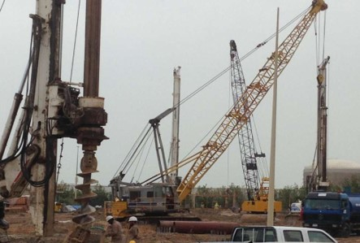
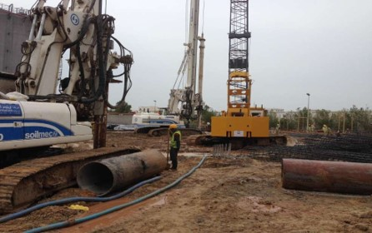
FUJAIRAH PORT
Type: Pilling
SOW: 366 Piles Dia 1000mm, 800mm, Height 25meters
Location: Fujairah - UAE

Slide 64
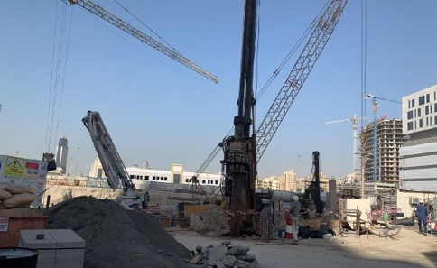
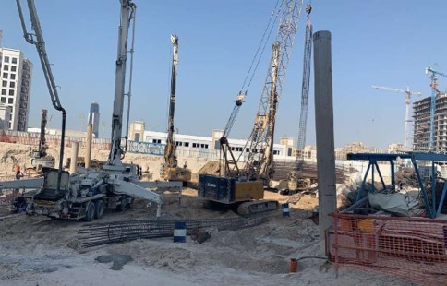
BIN GHATI AVENUE
Type: Pilling
SOW: 370 Piles Dia 1000mm, 900mm, Height 26meters
Location: Al Jadaf - Dubai - UAE
Consultant: Silver Stone Engineering
Main Contractor: Granada Europe Engineering

Slide 65
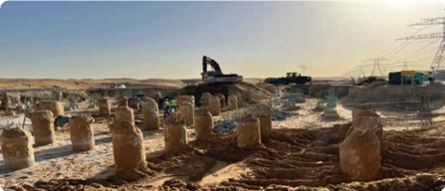
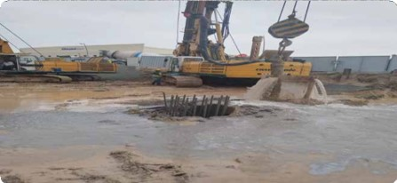
BYOTAWIR 132/11 KVA SUBSTATION
Type: Pilling
SOW: 247 Piles Dia 800mm, Height 17meters
Location: Al Awair - Dubai - UAE
Consultant: Lead Engineering
Main Contractor: AG POWER
Client: DEWA

Slide 66
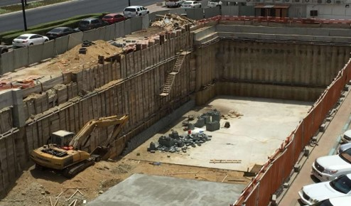
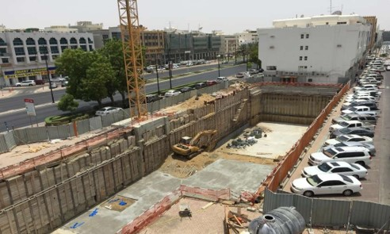
AL MALIKA MALL
Type: Shoring
SOW: Shoring work by steal beams 657 L.M
Location: Al Ain - UAE
Client: Al Malika Mall

Slide 67
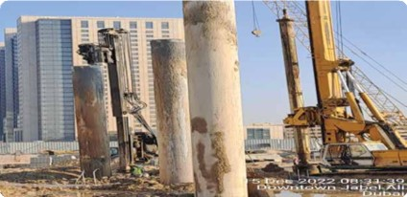
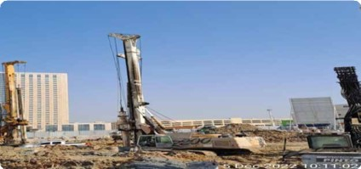
Mixed Use Building G+4P+19TYP+R
Type: Pilling
SOW: 242 Piles Dia 900mm, 1000mm, Height 27 & 30meters
Location: Plot No. DJAZIUBC10MIX032A2 Jabal Ali - Dubai - UAE
Consultant: Design Center
Main Contractor: Progress Constructions
Client: R.S Investment Limited

Slide 68
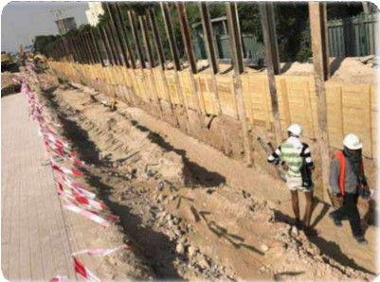
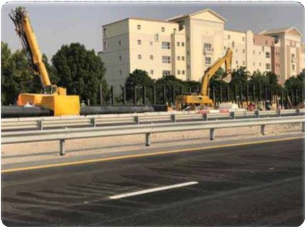
UGCHWP NETWORK AKOYA
Type: Shoring
SOW: 1600L.M Shoring work by steal beam
Location: Hessa St. - Dubai - UAE
Consultant: Jouzy Consultants Engineering
Main Contractor: Al Nasr Contracting
Client: AKOYA

Slide 69
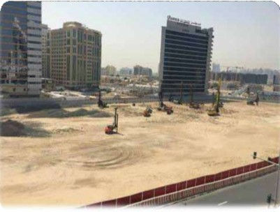
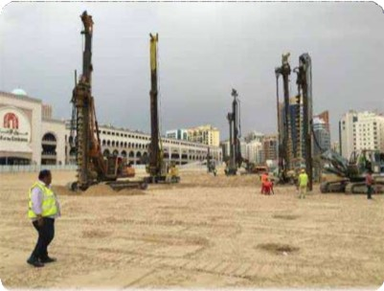
13 Nos Commercial Building
Type: Piling | Shoring | Soil Improvement
SOW: 101 Piles, Dia 600mm, hight 18M | 473L.M Shoring work by steal beam | 4055M2 Stone Column
Location: Plot No. 3731116 Al Barsha First - Dubai - UAE
Consultant: Arif & Bintoak
Main Contractor: City Greek
Client: Mozon Holding

Slide 70
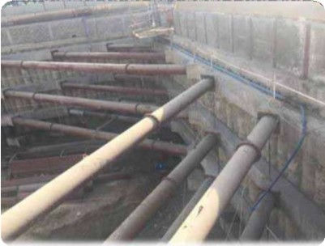
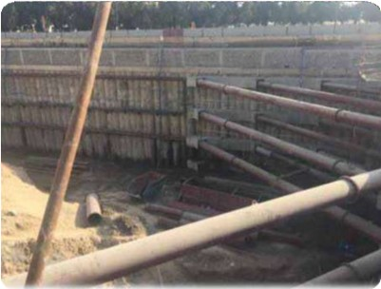
4B+G+14+R Comm. & Res. Building
Type: Shoring
SOW: 324 Secant Piles Dia 600mm, Hight 8Meters
Location: Plot No. 134042 Al Mamzar - Dubai - UAE
Consultant: Inspiration Consultants Engineers
Main Contractor: MESC Contracting

Slide 71
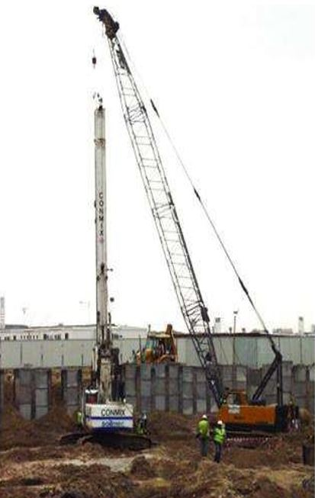
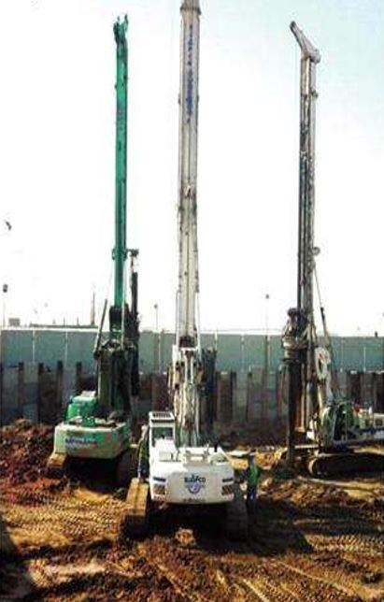
PRUDENTIAL TOWER
Type: Piling
SOW: 362Piles Dia 600mm, Hight 12Meters
Location: Jumeirah Village - Dubai - UAE
Consultant: Whitby & Bird
Client: Mr. Haytham Al Tajir

Slide 72
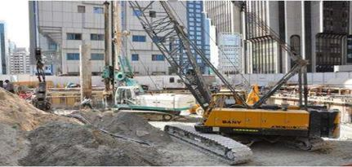
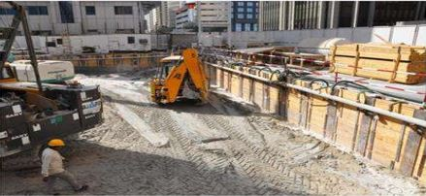
UNION TOWER
Type: Piling | Shoring
SOW: 173 Piles, Dia 900mm, Hight 16M | 120L.M Shoring work by steal beam
Location: Sector E7 Plot No. C-40 – Abu Dhabi - UAE
Consultant: Golden Planners Consultants
Main Contractor: Construction General Contracting House

Slide 73
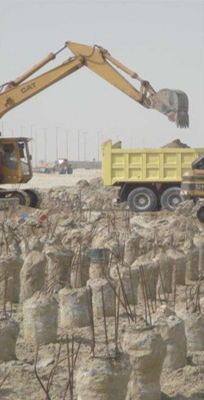

ALUMEX FACTORY
Type: Piling
SOW: 322Piles Dia 800mm, Hight 18Meters
Location: Plot 59 G27 Industrial City – Abu Dhabi - UAE
Consultant: Cerex International Consultant
Main Contractor: Bukhatir Contracting
Client: BuKHatir Group

Slide 74


HOTEL APPARTMENT
Type: Piling | Shoring
SOW: 210 Piles, Dia 800mm, Hight 23M | 90L.M Shoring work by steal beam
Location: Sector E16 Plot No. C-29 – Abu Dhabi - UAE
Consultant: Al Fajir Engineering Consultants
Main Contractor: Al Mezen General Contracting

Slide 75


STEEL FACTORY
Type: Piling
SOW: 189 Piles, Dia 600mm, Hight 14.3M
Location: Sector M41 Plot No. 13E2 – Abu Dhabi - UAE
Consultant: The Arab Office for Planning & Architecture
Main Contractor: Fibrex

Slide 76
OUR
CLIENTS FEEDBACK
BACK TO
MAIN

Slide 77


Slide 78


Slide 79


Slide 80


Slide 81


Slide 82


Slide 83


Slide 84


Slide 85


Slide 86


Slide 87


Slide 88


Slide 89


Slide 90


Slide 91


Slide 92


Slide 93
COMPLETION CERTIFICATES
BACK TO
MAIN

Slide 94





Slide 95





Slide 96





Slide 97
OUR
EQUIPMENT'S
BACK TO
MAIN

Slide 98

PILING & SHORING EQUIPMENT'S
 | Description | Brand | Origin
1 | Piling Rig B 250 | Gasagrandi | Italy
2 | Piling Rig MT8 - With Tire | Might | Italy
3 | Piling Rig th10-25 | CMV | Italy
4 | Piling Rig th15-50 | CMV | Italy
5 | Piling Rig TES-Car | TES CAR | Italy
6 | Micro Pile TES-20 | TES CAR | Italy
7 | Micro Pile TES-30 | TES CAR | Italy
8 | Anchor Rig C-6 | Casagrande | Italy
9 | Anchor Rig C-6 | Casagrande | Italy
10 | Anchor Rig C-8 | Casagrande | Germany
11 | Anchor Rig C-6 | Casagrande | Germany
12 | ABI SHORING RIG R912 | ABI/O&K | Germany

Slide 99


PILING & SHORING EQUIPMENT'S
 | Description | Brand | Origin
13 | ABI SHORING RIG R910 | ABI/O&K | Germany
14 | ABI SHORING RIG R812 | ABI/O&K | Germany
15 | ABI SHORING RIG R810 | ABI/O&K | Germany
16 | ABI SHORING RIG 921 | ABI/O&K | Germany
17 | ABI SHORING RIG ZR28 | ABI/Sennebogen | Germany
18 | ABI SHORING RIG ZR26 | ABI/Sennebogen | Germany
19 | Board Pile BG22H | BAUER | Germany
20 | Board Pile C600 | Casagrande | Italy
21 | Piling Rig 240 LS | Trevi | Italy
22 | ABI SHORING RIG | Zeplin | Belgium
23 | ABI SHORING RIG 225DLC | Caterpillar | Belgium

Slide 100



SERVICE CRANE & VIBRATOR
 | Description | Brand | Origin
1 | Crawler Crane - 100 TON | XCMG | Chaina
2 | Crane - 35 TON | GROVE RT | USA
3 | Crane - 25 TON | GROVE RT | USA
4 | Crane - 30 TON | LOCATELLI | Italy
5 | SCC500D 50 TON | SANY | Chaina
6 | SCC500D 50 TON | SANY | Chaina
7 | 0PAJOT1 | PAJOT | USA
8 | Vibrator J&M815 | ICE | USA

Slide 101
TEST EQUIPMENT'S
 | Description
1 | Crown beam 2500 ton
2 | Complete set up to 1000 tons (Beams)
3 | Complete set up to 2000 tons (Beams)
4 | Hydraulic jack 1000 tons
5 | hydraulic jack 1500 tons
6 | Dial gaquges
BENTONITE ACCESSORIES
 | Description | Brand | QTY
1 | Desander 100 m3 / hr | Soilmec | 01
2 | Bentonite & water tank 24 m3 |  | 06
3 | Grouting Pump | Postmizer | 06
4 | Mixer | Soilmec | 03
5 | Concrete Pump | Putzmeister | 01
6 | Concrete Pump | Mecbo | 01

Slide 102
OUR
CLIENTS
BACK TO
MAIN

Slide 103













OUR
CLIENTS

Slide 104












OUR
CLIENTS

Slide 105












OUR
CLIENTS

Slide 106












OUR
CLIENTS

Slide 107

GET IN TOUCH
+971 4 2634300
INFO@MEGATECHCONT.AE
P.O.Box: 89673 BVS Business Center - Al Barsha Valley Dubai - UAE
WWW.MEGATECHCONT.AE
@YOURSOCIALMEDIA

Slide 108
2024 Projects
# | Project Details | Work Description | Client
1 | Etihad Rail, Stage 2Package 2D -Noise Barrier - UAE | 325 Pile, 650mm dia | Elite Road Supplies Co. ECO / Etihad Rail
2 | Dubai International Airport | 24 L.M Temporary Shoring by Steel Beams, 26 L.M Temporary Shoring by Sheet Pile | Al Darwish Building Contracting
3 | G + 3P + 6 FLOORS + ROOF LOCATION : AL WARQA'A FIRST - DUBAI UAE | 81 L.M Temporary Shoring by Steel Beams | JAMS Contracting
4 | DEWA 731009-132kV Shunt Reactors at TREATPLT, QSSE,TRMN & DMCY Substations | 16 L.M Temporary Shoring by Steel Beams | AG Power / DEWA
5 | Dubai Hills Villa 68 DH-4024, Plot no -6314122 | 40 L.M Temporary Shoring by Steel Beams, 51 L.M Permanent Shoring by Steel Beams, 56 L.M Shoring by Secant Pile | Design Hub Building Contracting
6 | Commercial Building (G+1) - DUBAI - UAE , Plot No. 266 –2270 Oud Al Muteena 2nd | 28 L.M Temporary Shoring by Steel Beams | Qaleat Al Zaman Contracting L.L.C
7 | DMS 148741 - Design & Build of BHRTWRSN 132/11kV Substation at International City, Phase-2,3 | 68 L.M Temporary Shoring by Steel Beams | AG Power / DEWA
8 | (B+G+1+R) Villa, Plot No. 6314210, Dubai Hills - U.A.E | 131 L.M Temporary Shoring by Steel Beams | DHCN Contracting L.L.C
9 | G+1 Villa, Al Mamsha - Sharjah - U.A.E | 120 L.M Temporary Shoring by Steel Beams | Al Hamad Building Contracting L.L.C
10 | Villa (B+G+1)+ Roof, plot No 6317086 at Hadaeq Sheikh Mohammed Bin Rashid UAE | 51 L.M Temporary Shoring by Steel Beams, 22 L.M Permanent Shoring by Steel Beams, 31 L.M Shoring by Secant Pile | Design Hub Building Contracting
11 | Ground Floor Villa, Plot No. 541, Sakamkam - Fujairah - U.A.E | 36 Pile 600mm Dia | Mozoon Engineering
12 | (G+4) Residential Building, Plot No. 309020023 - Al Dafan ST-AL Mairid – Ras Al Khaima – U.A.E | 56 Pile, 600mm Dia, 34 Pile 1000mm Dia, Static Load test, Dynamic, Sonic test | Harvard Contracting L.L.C
13 | Villa (B+G+1) - Masafi - Ras Al Khaimah - UAE | Grouting, Injection Works | Mr. Ahmad Al Mahrazi
14 | Modification Works at Existing Facility at Plot no: 597-0611 - Dubai Investment Park, Dubai - UAE. | 65 L.M Temporary Shoring by Steel Beams | Khair Al Amal Building Contracting LLC
15 | B+G+5Floor Residential Building on Plot No. JVC15RMRRA700DA at Jumeirah Village Circle, Dubai – U.A.E. | 307 L.M Temporary Shoring by Steel Beams | Elite Overseas Building Contracting
16 | B+G+1 residential Vilka, PLOT NO. 6314230Dubai Hills, Dubai-UAE | 103 L.M Temporary Shoring by Steel Beams, 23 L.M Secant Pile | JEIKOR Contracting L.L.C

Slide 109
2024 Projects
# | Project Details | Work Description | Client
17 | G+1 VILLA + Boundary wall, Plot No. 111020075 – Seeh Al Qurum – Ras Al Khaimah – U.A.E | 77 nos. Soil Improvement by Stone Column | APCO Contracting
18 | G+1 VILLA, Plot No.111160055 – Al Rams – Ras Al Khaimah – U.A.E | 91 nos. Soil Improvement by Stone Column | Sham Engineering
19 | D B+G+1+R Villa, Plot No. 6314148 - Dubai Hills | 141 L.M Temporary Shoring by Steel Beams | DHCN Contracting L.L.C

